Slide 1
Innisfail Primary Health Clinic
10 Ernest Street, Innisfail.

Slide 2
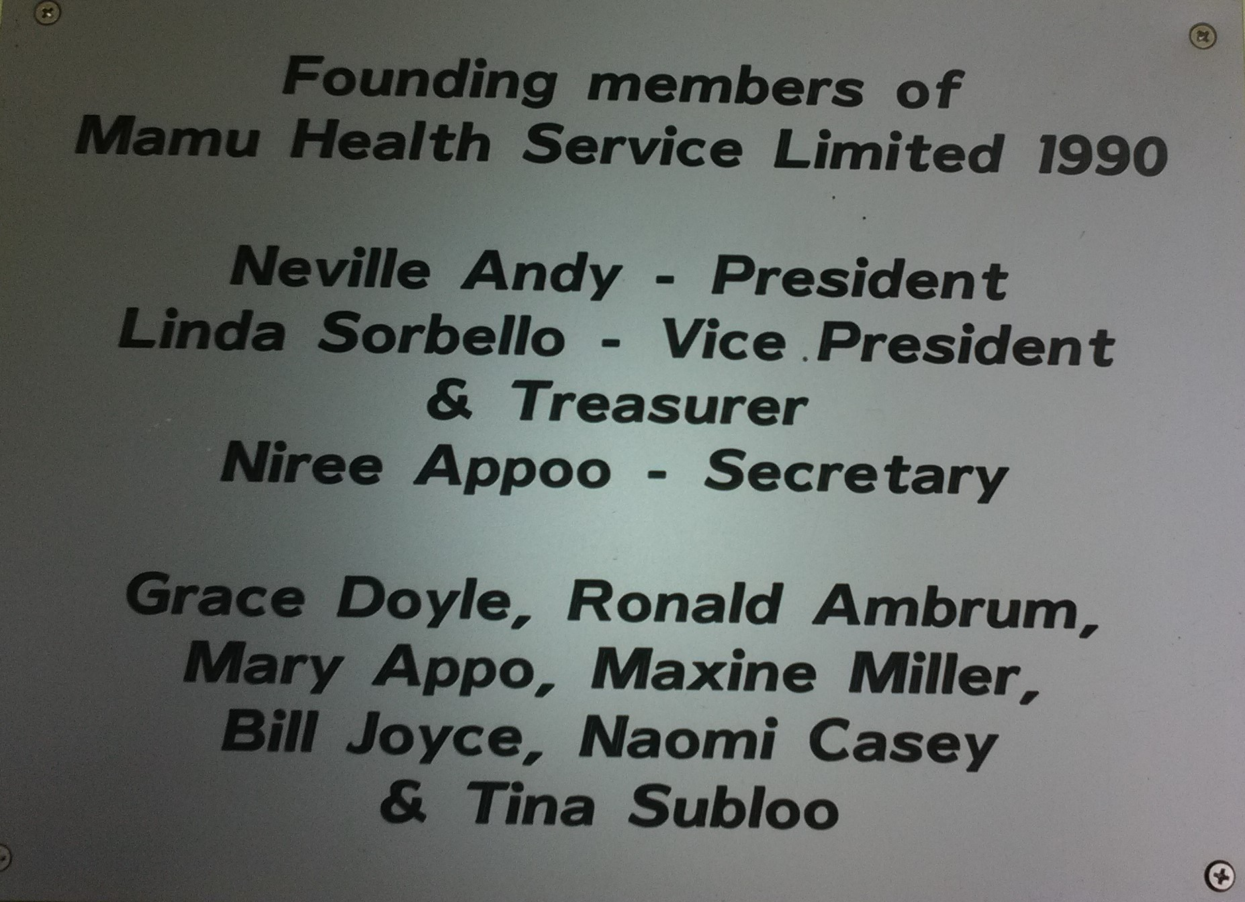
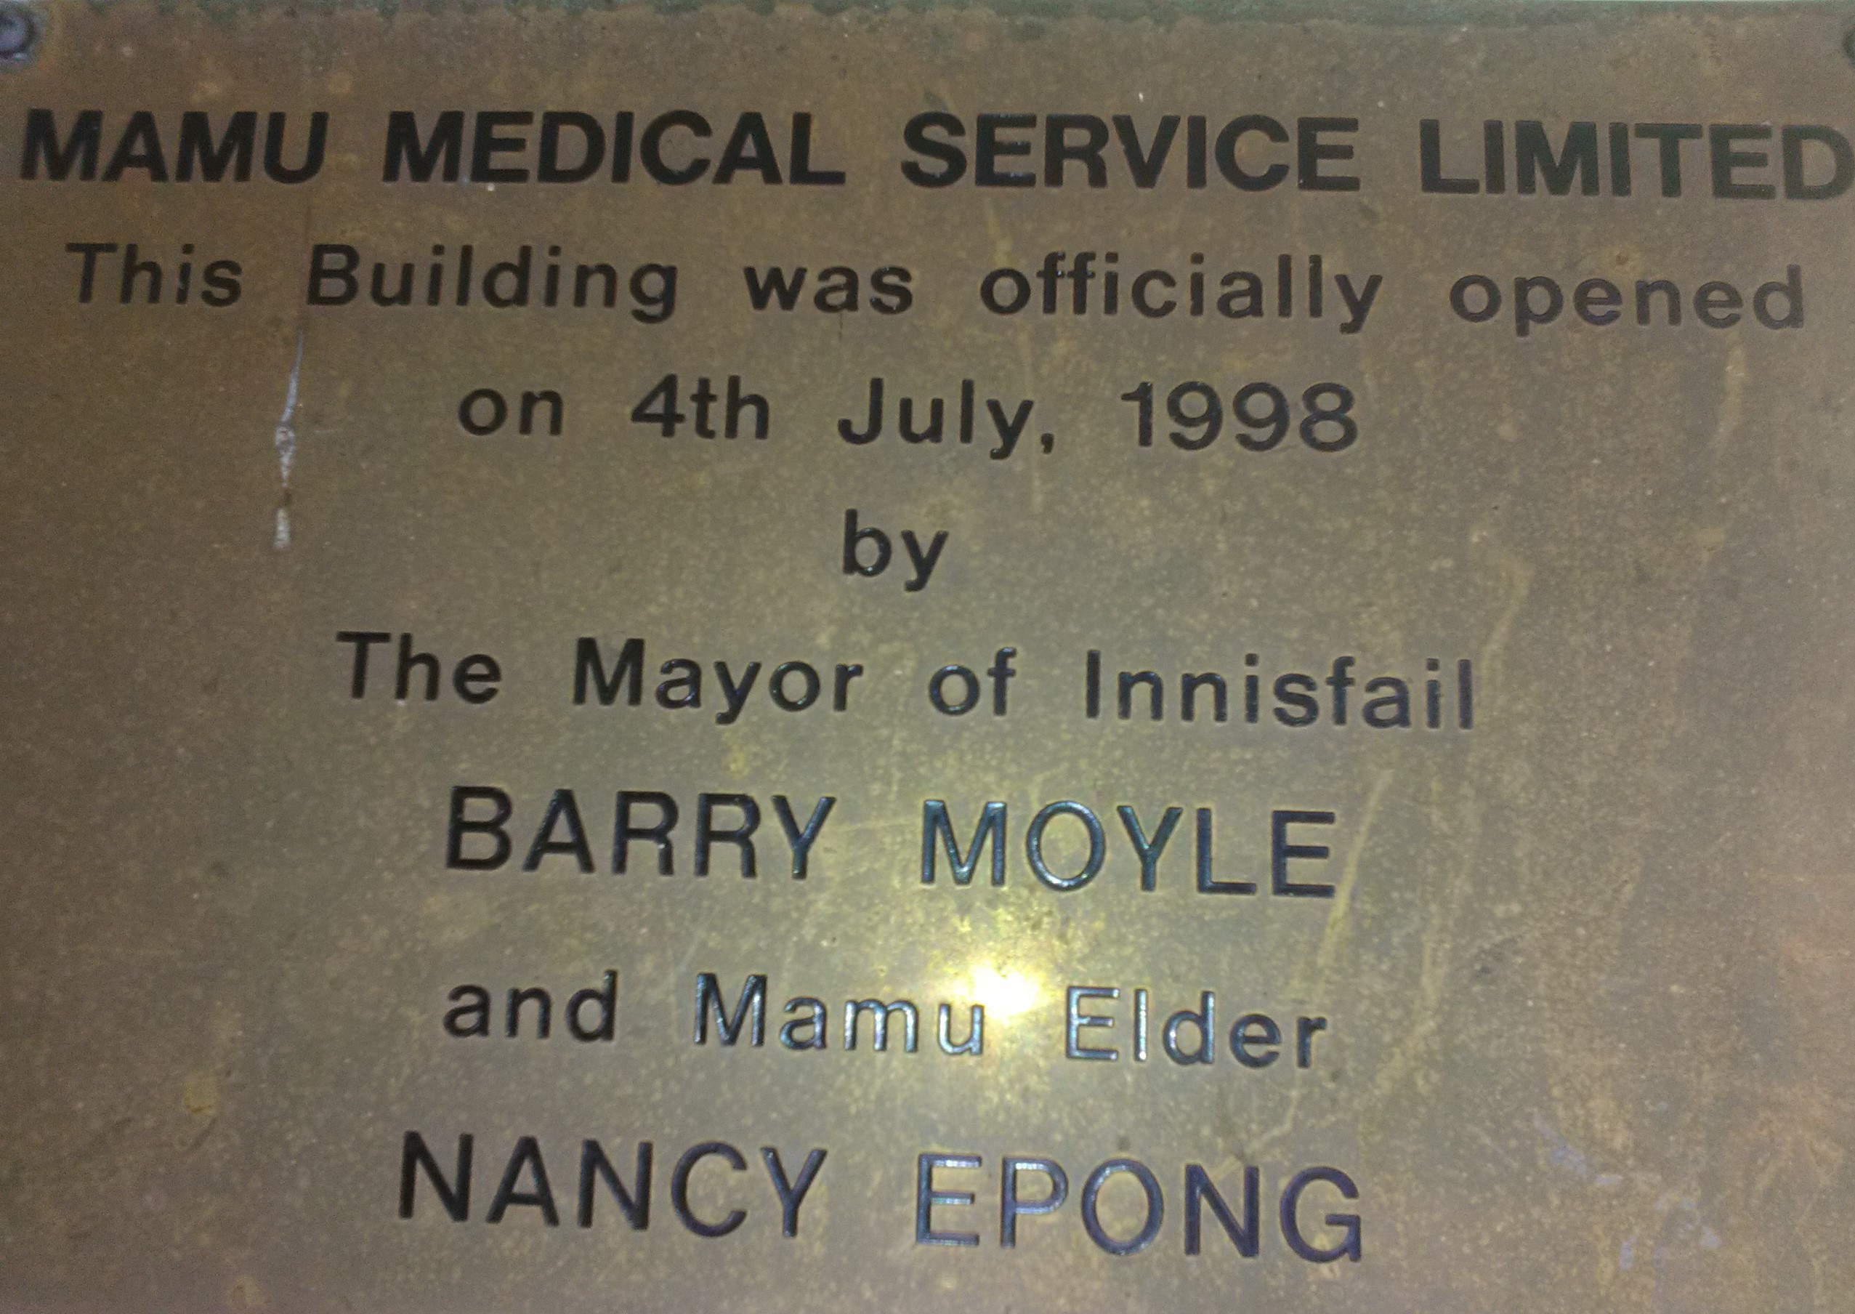
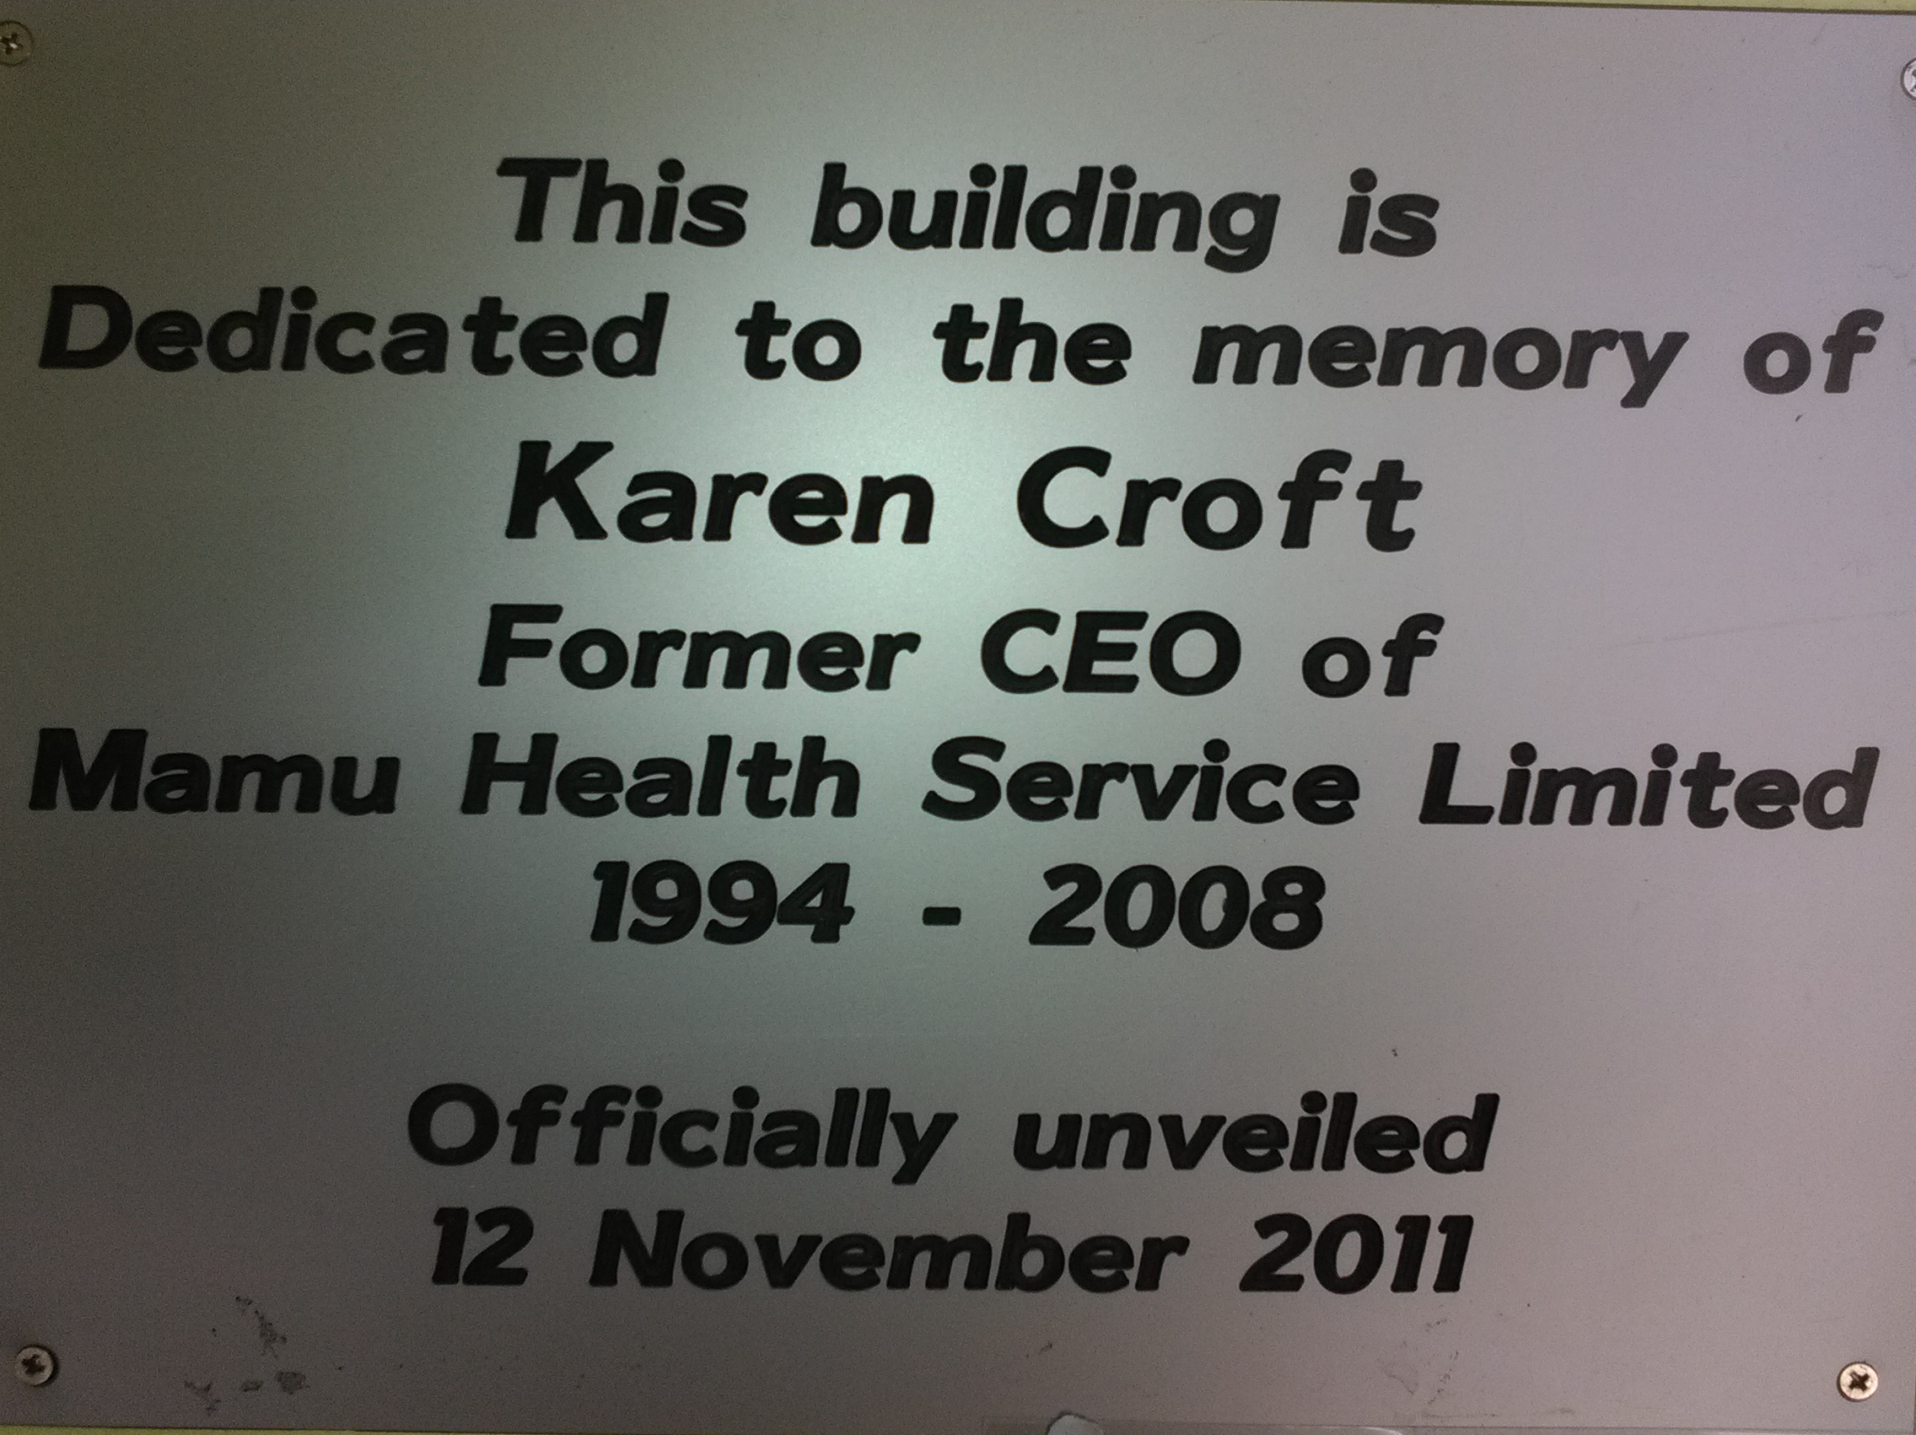
Mamu Health Service was founded in 1990. 10 Ernest Street was officially opened on 4th July 1998. The building was dedicated to the Former CEO, Karen Croft 1994 - 2008

Slide 3
Mamu Health Service – 10 Ernest Street. What do we do?
Mamu Health Service at 10 Ernest Street . What do we do?
Client Care – provide a doctor service 5 days a week.
Offer a Bulk Billing service - Medicare
Health Checks
Care plans
Wound management
Home visits
Provide transport to specialists appointments..
Community Engagement – NAIDOC, BMT, Worlds Greatest Shave (Leukemia), School Hearing Program.
Allied Health Professionals – Diabetes Educator, Dietitian, Ex Physiologist, Podiatrist, Pharmacist, Optometrist, Australian Hearing, Retinel Eye camera (taking photos of eyes)
Other services: Check up (Health worker –hearing).

Slide 4
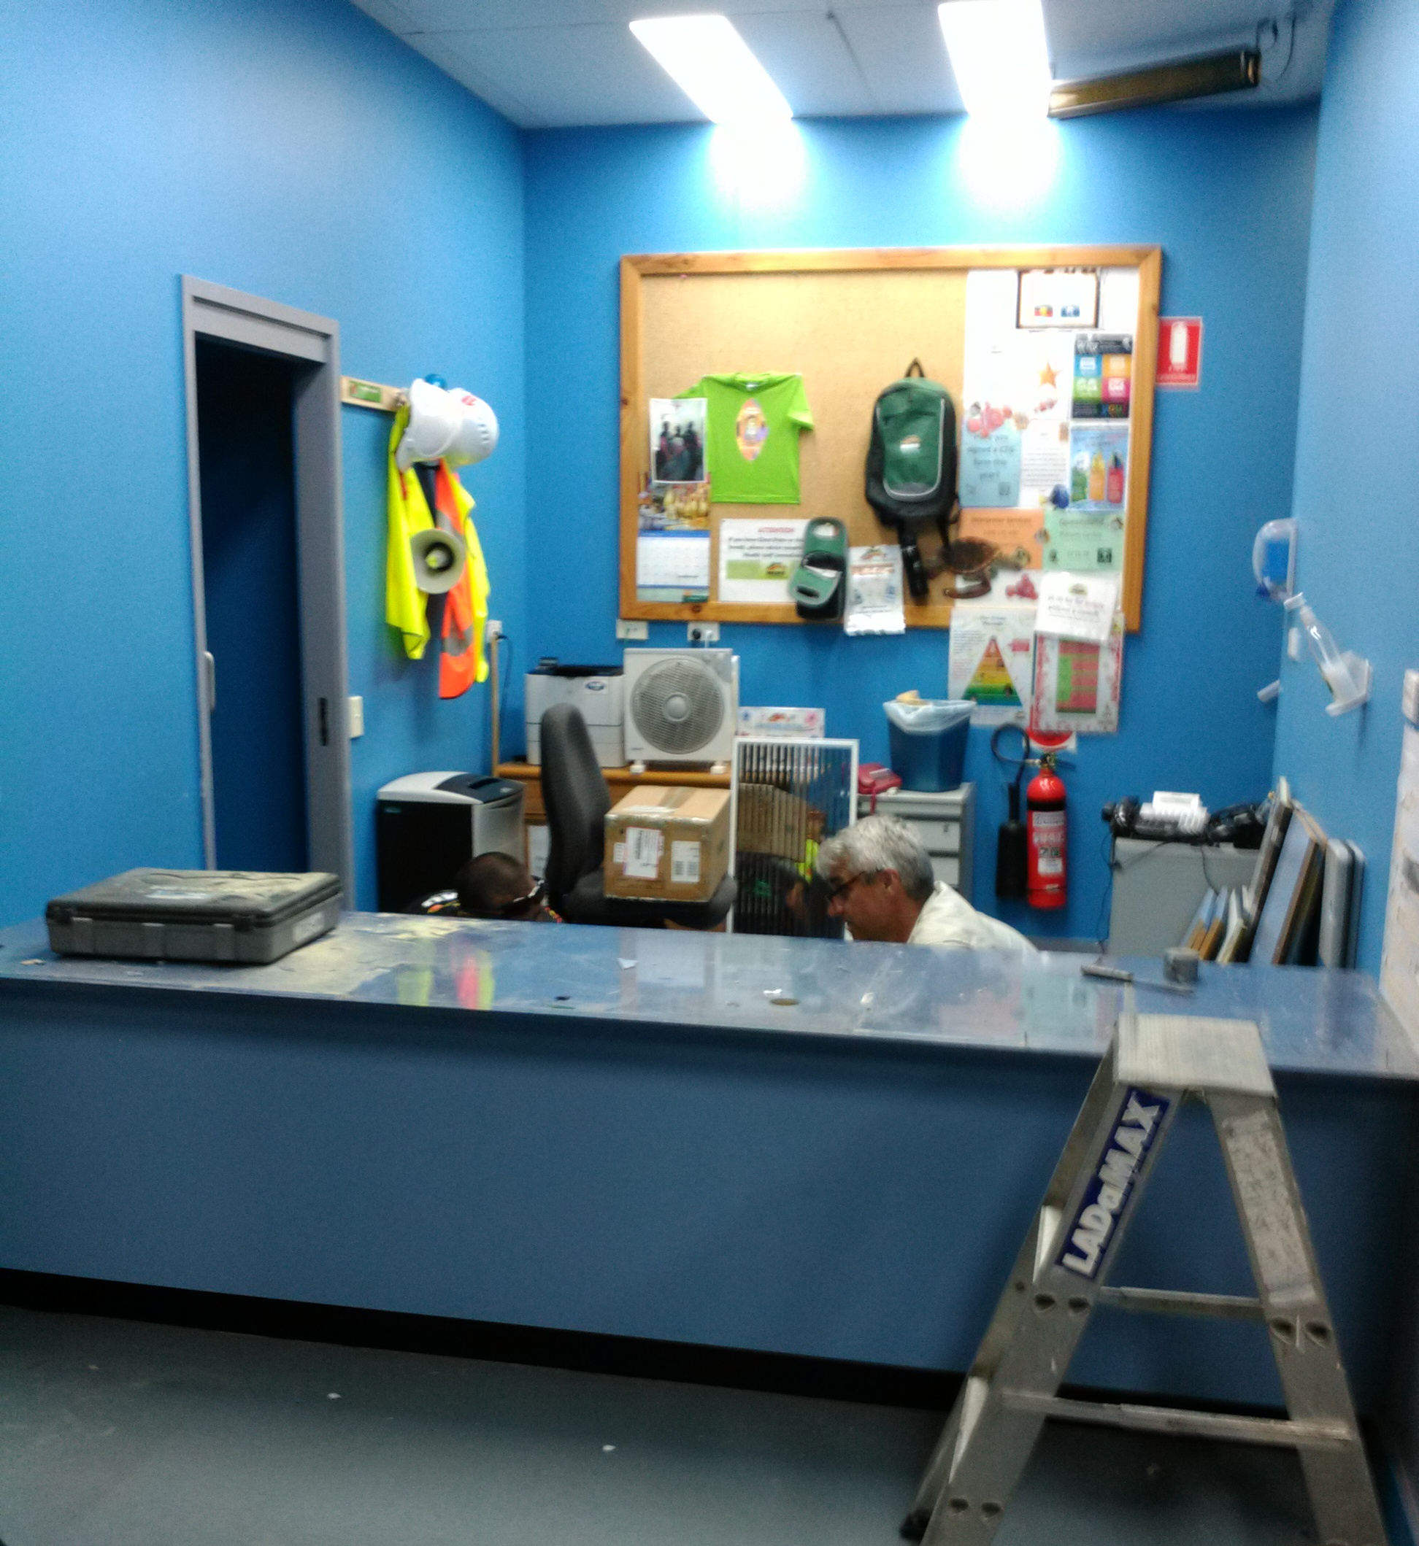
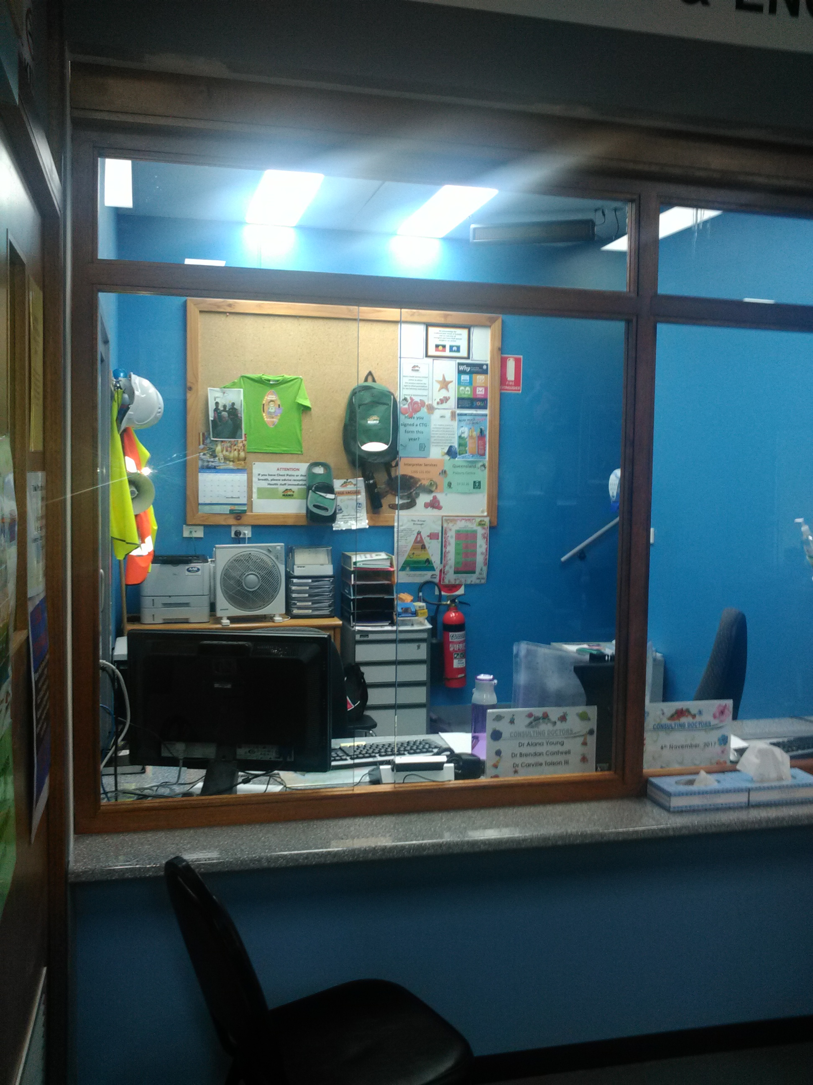
Facelift – old Reception desk to the new look…

Slide 5
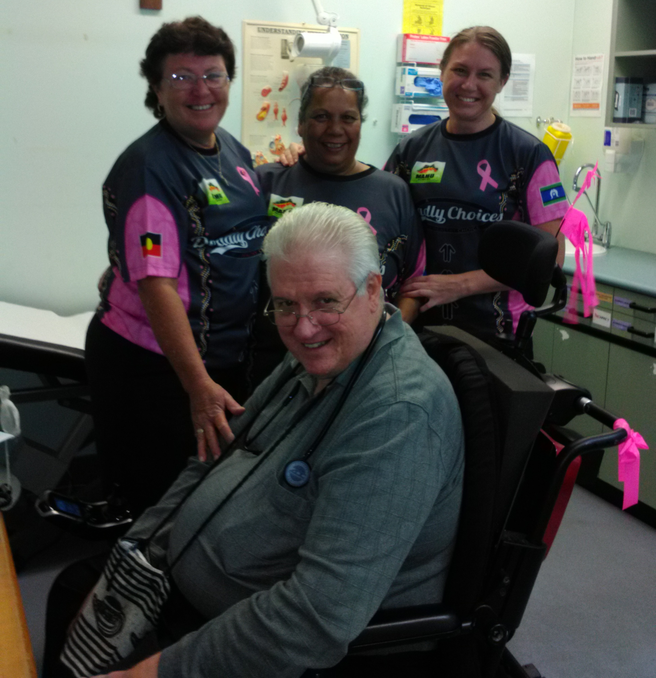
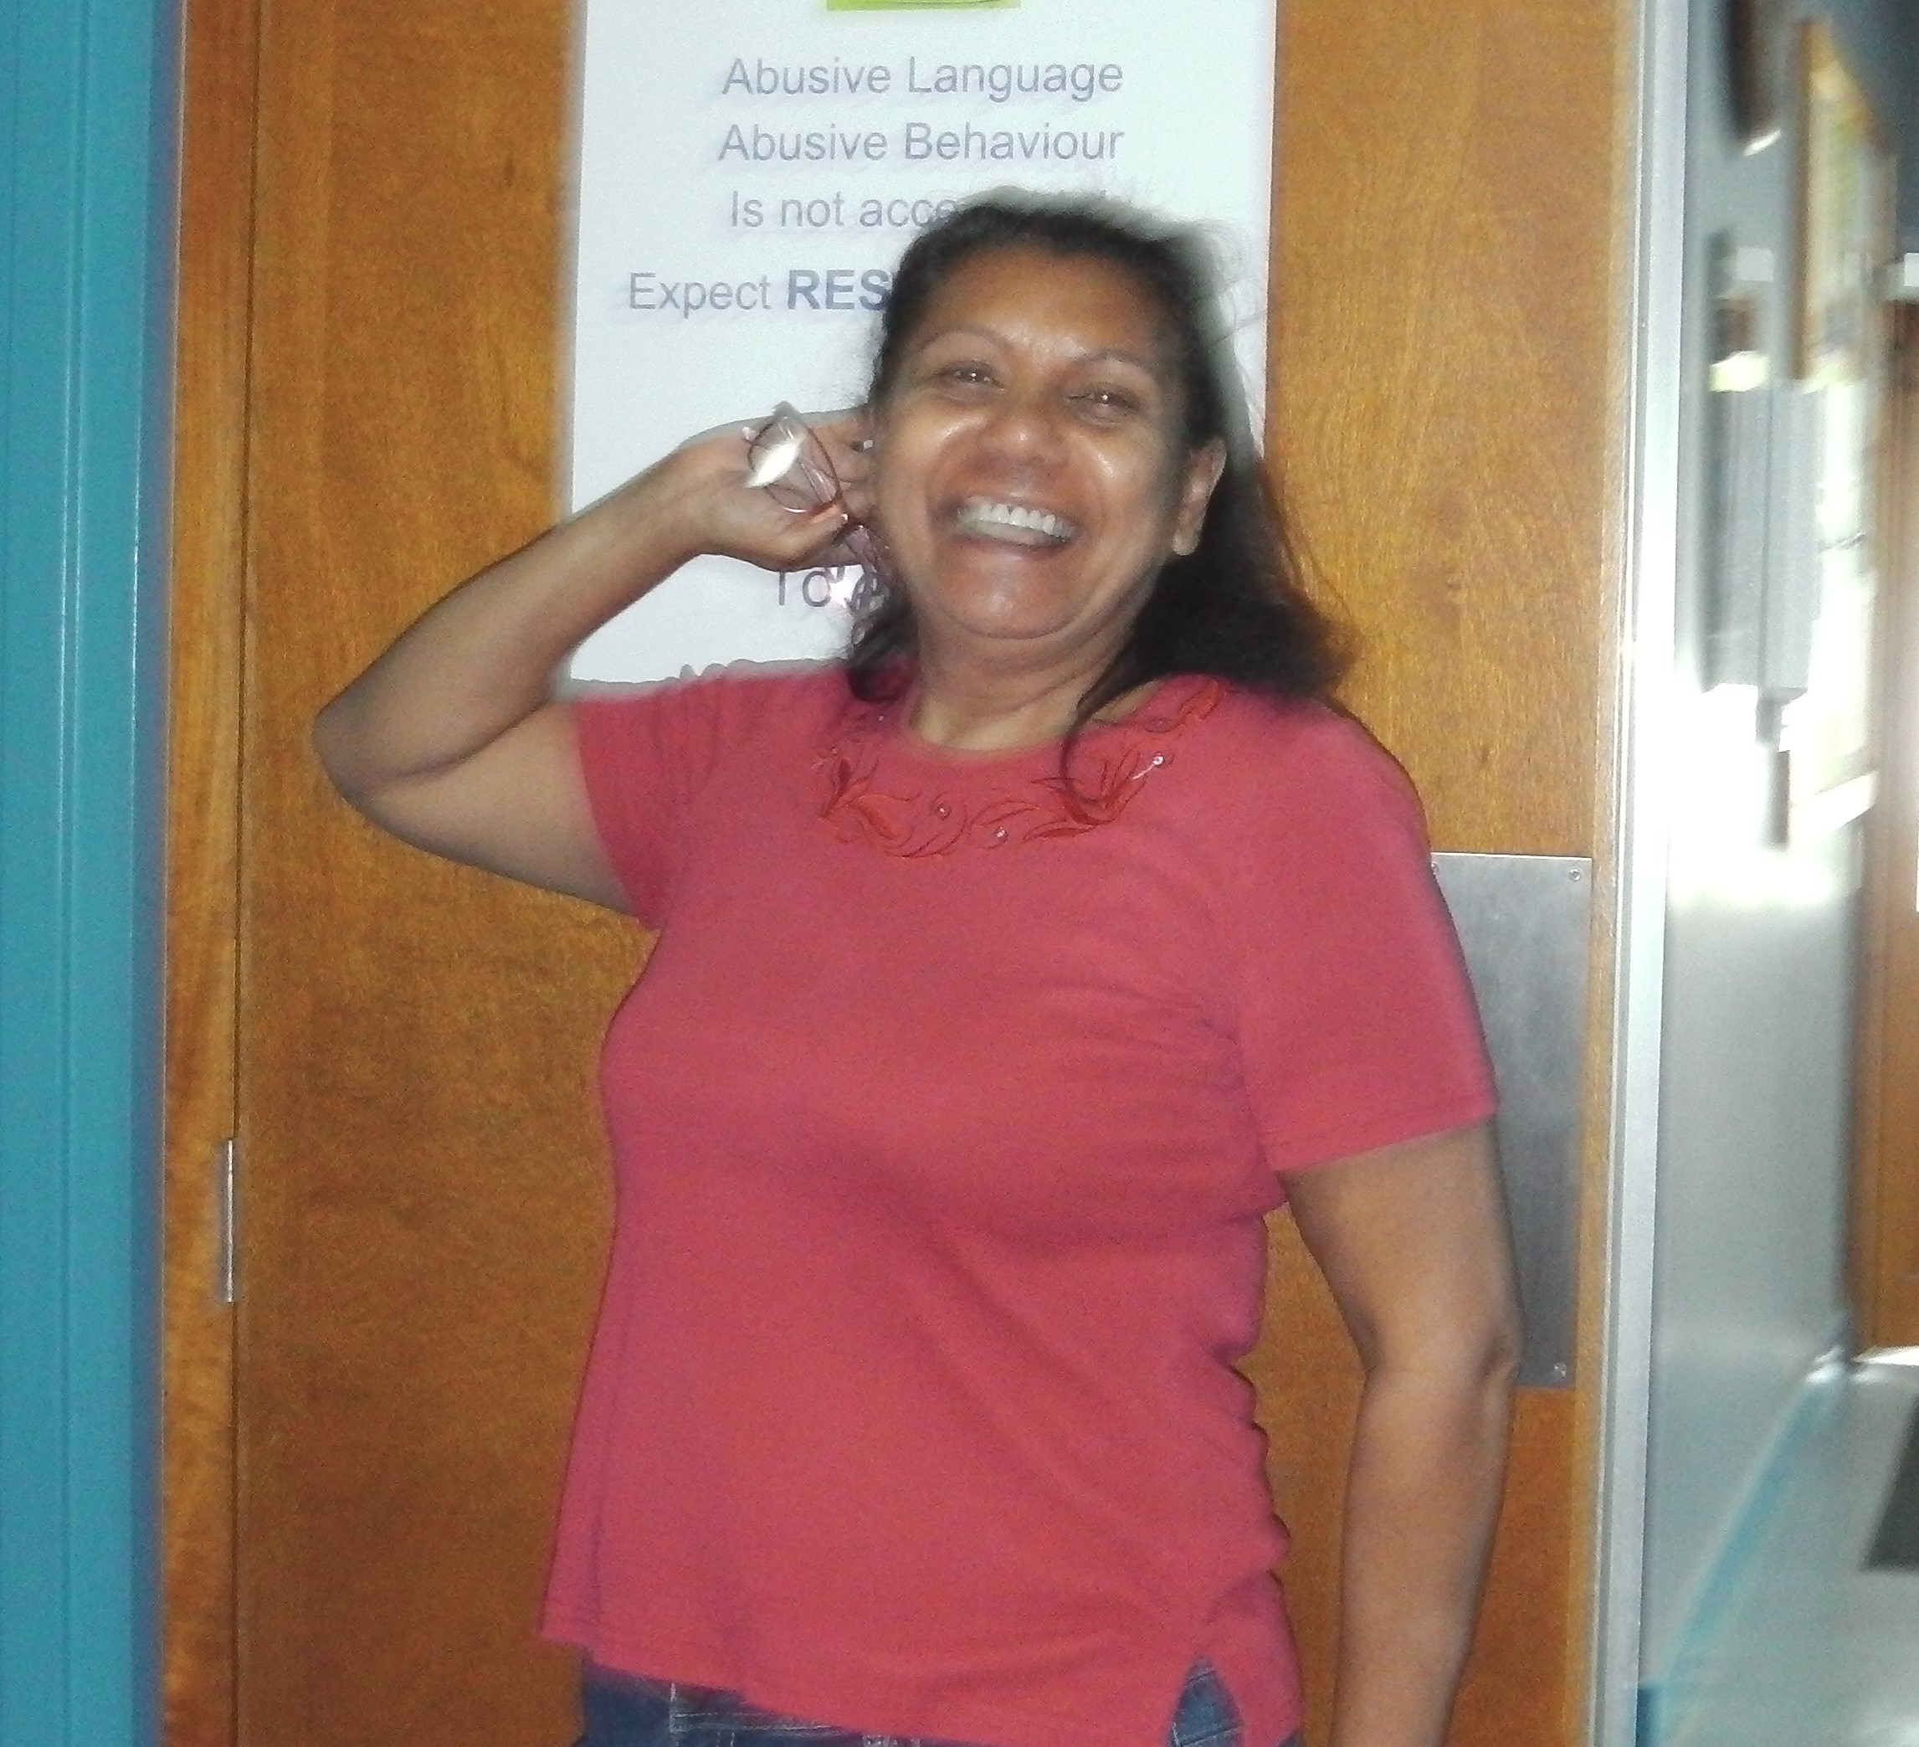
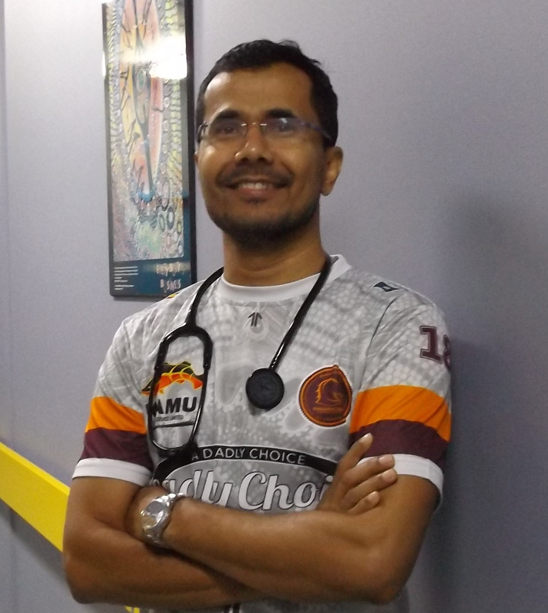
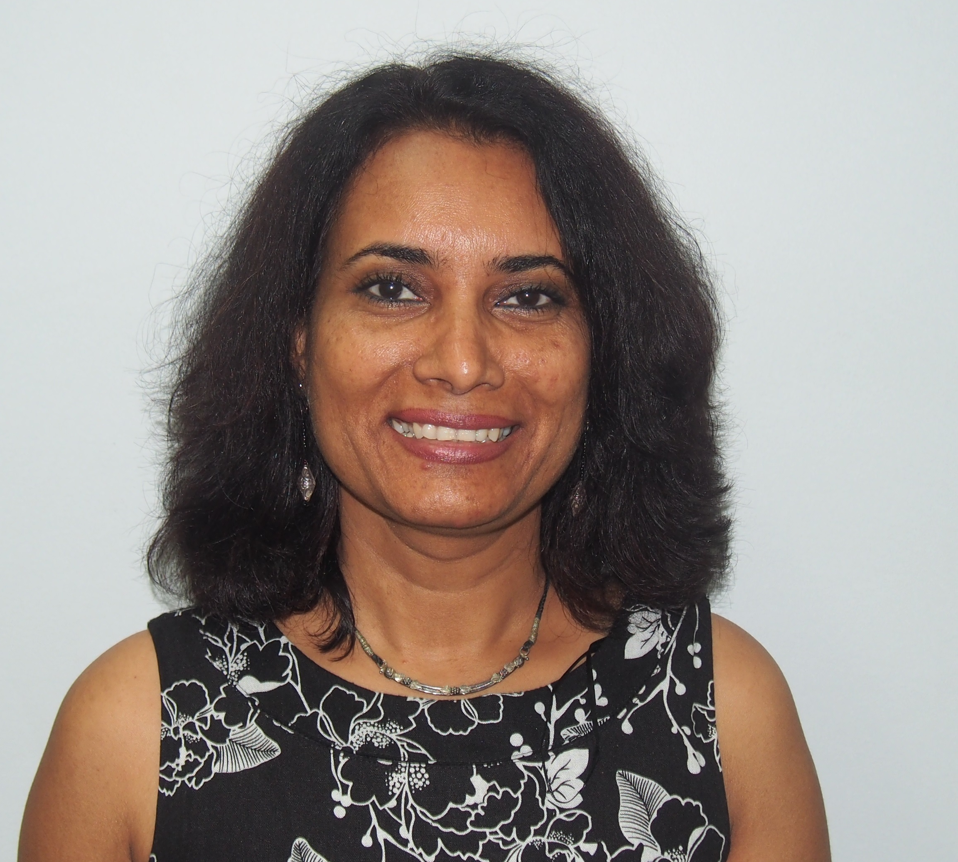
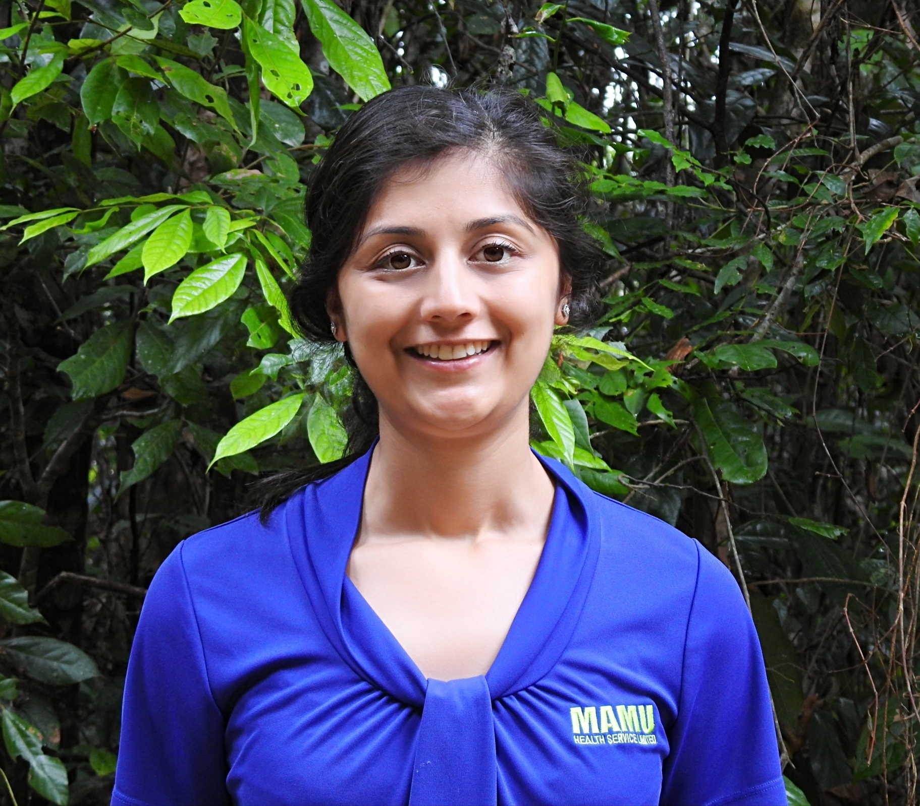
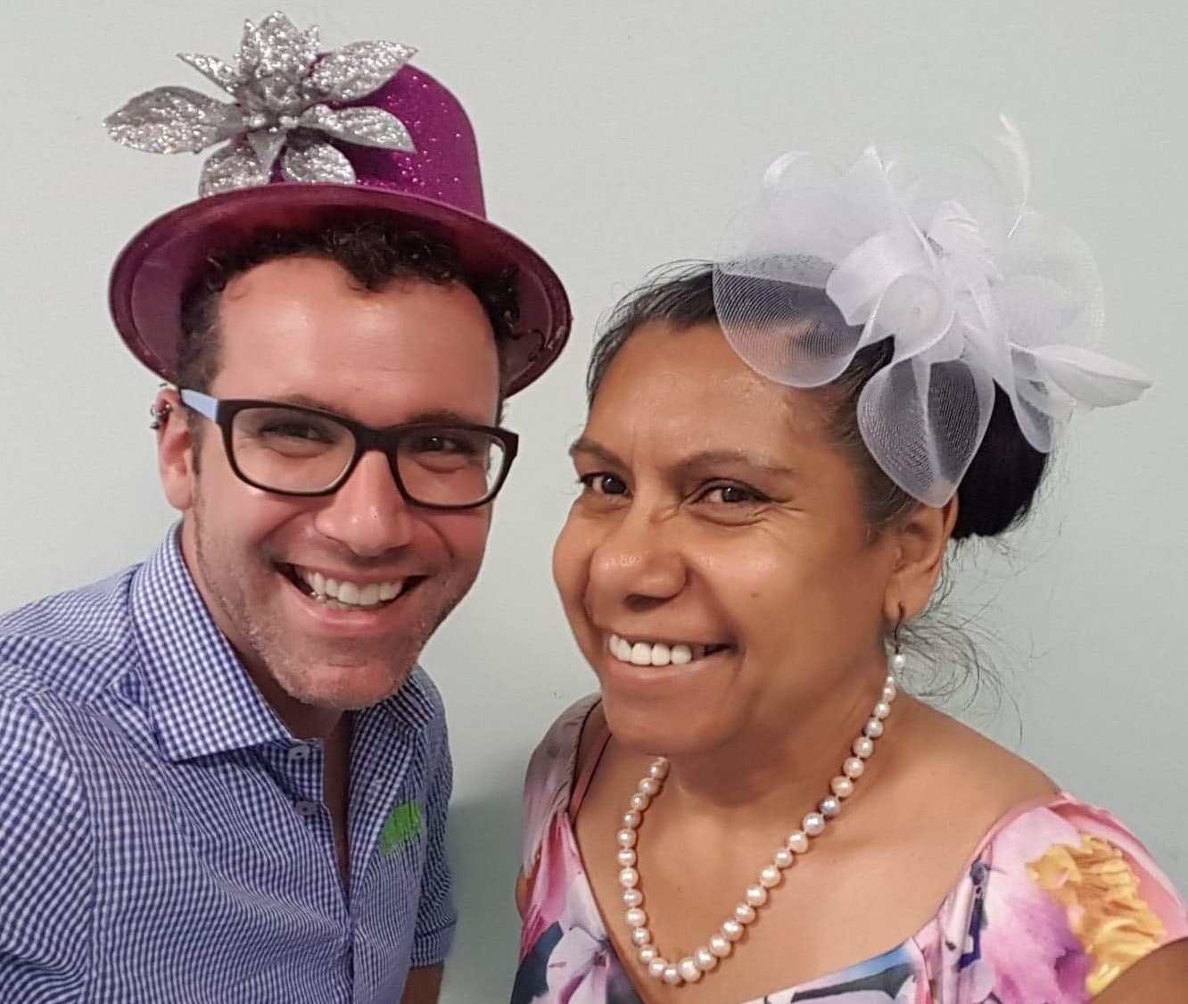
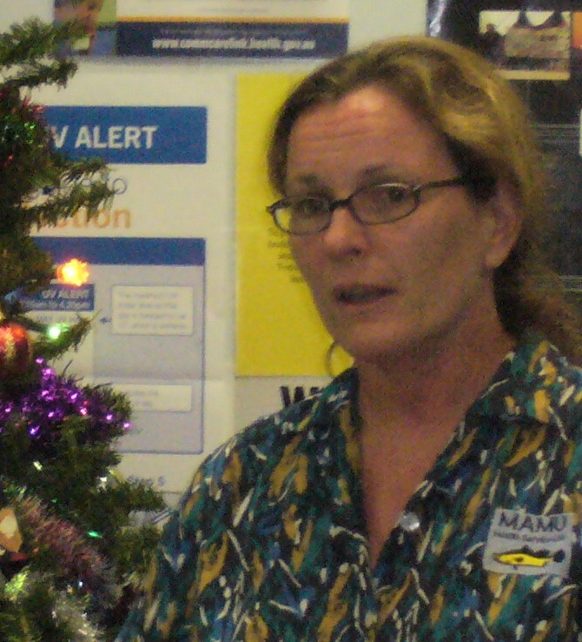
Doctors: Now & Then…
Kathy Harris, Freda Masina, Rebecca, Dr Carville
Dr Aleeta Fejo
Dr Simon
Dr Prasad
Dr Sarah Fatima
Dr Ayesha - Babinda
Dr Ian & Dr Aleeta – Melbourne Cup Mad Hat day
Dr Damian Byrnes –
PHC 10 Ernest Street
Dr Anila - Ravenshoe
Dr Nelle van Buuren

Slide 6
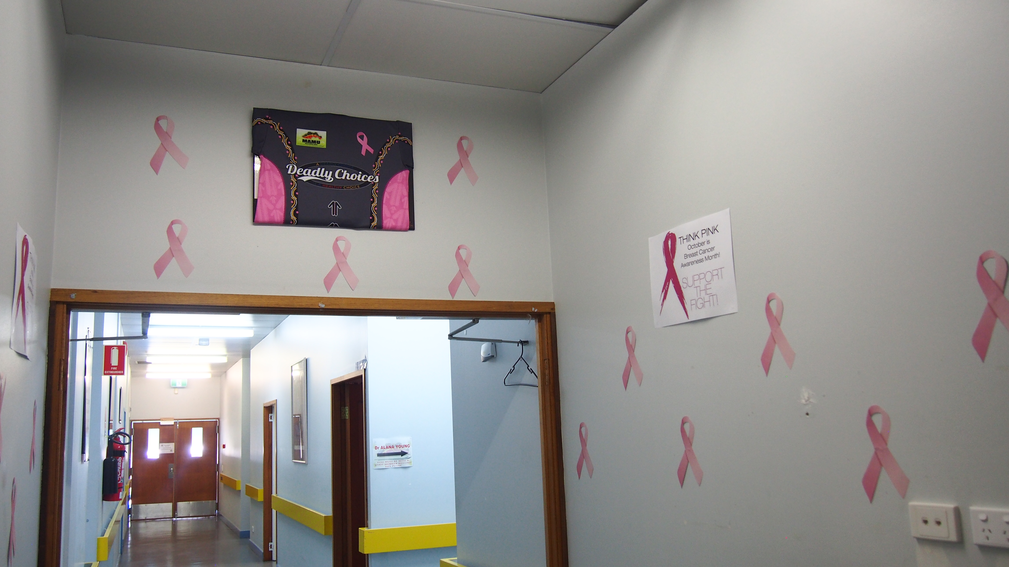
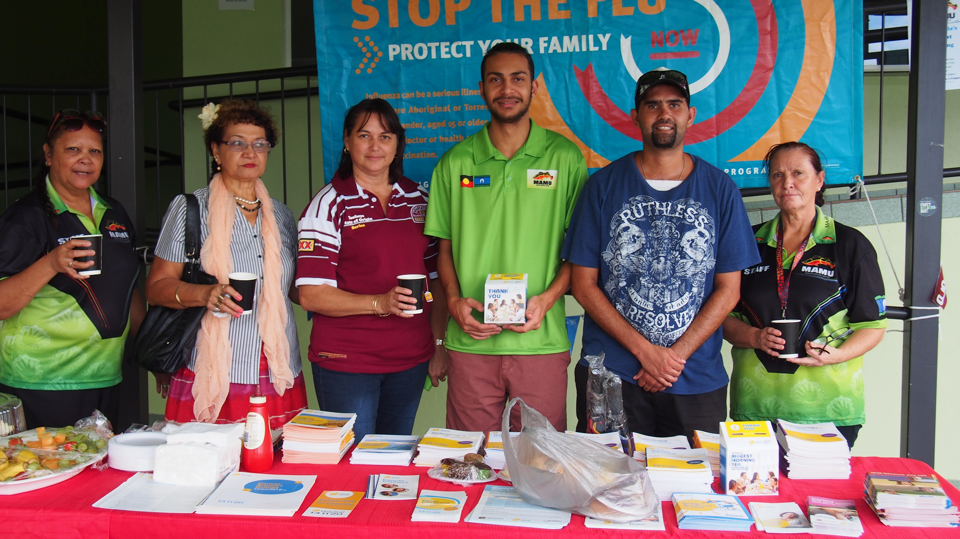
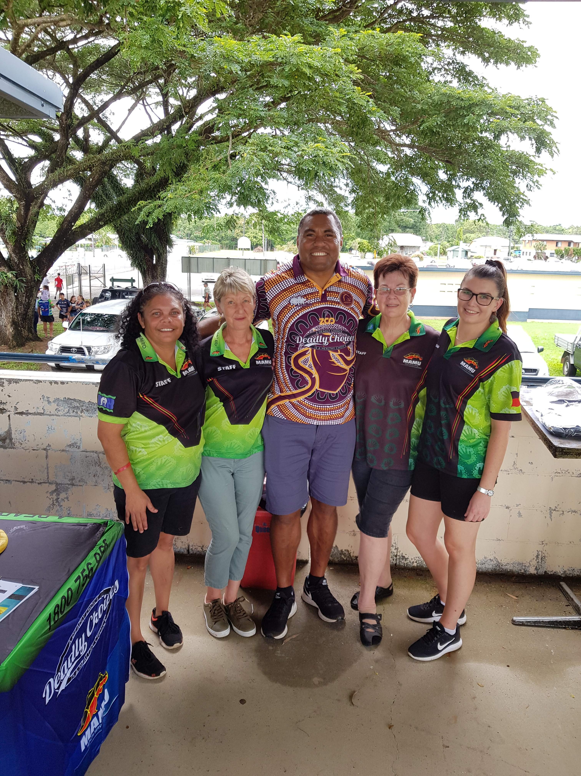
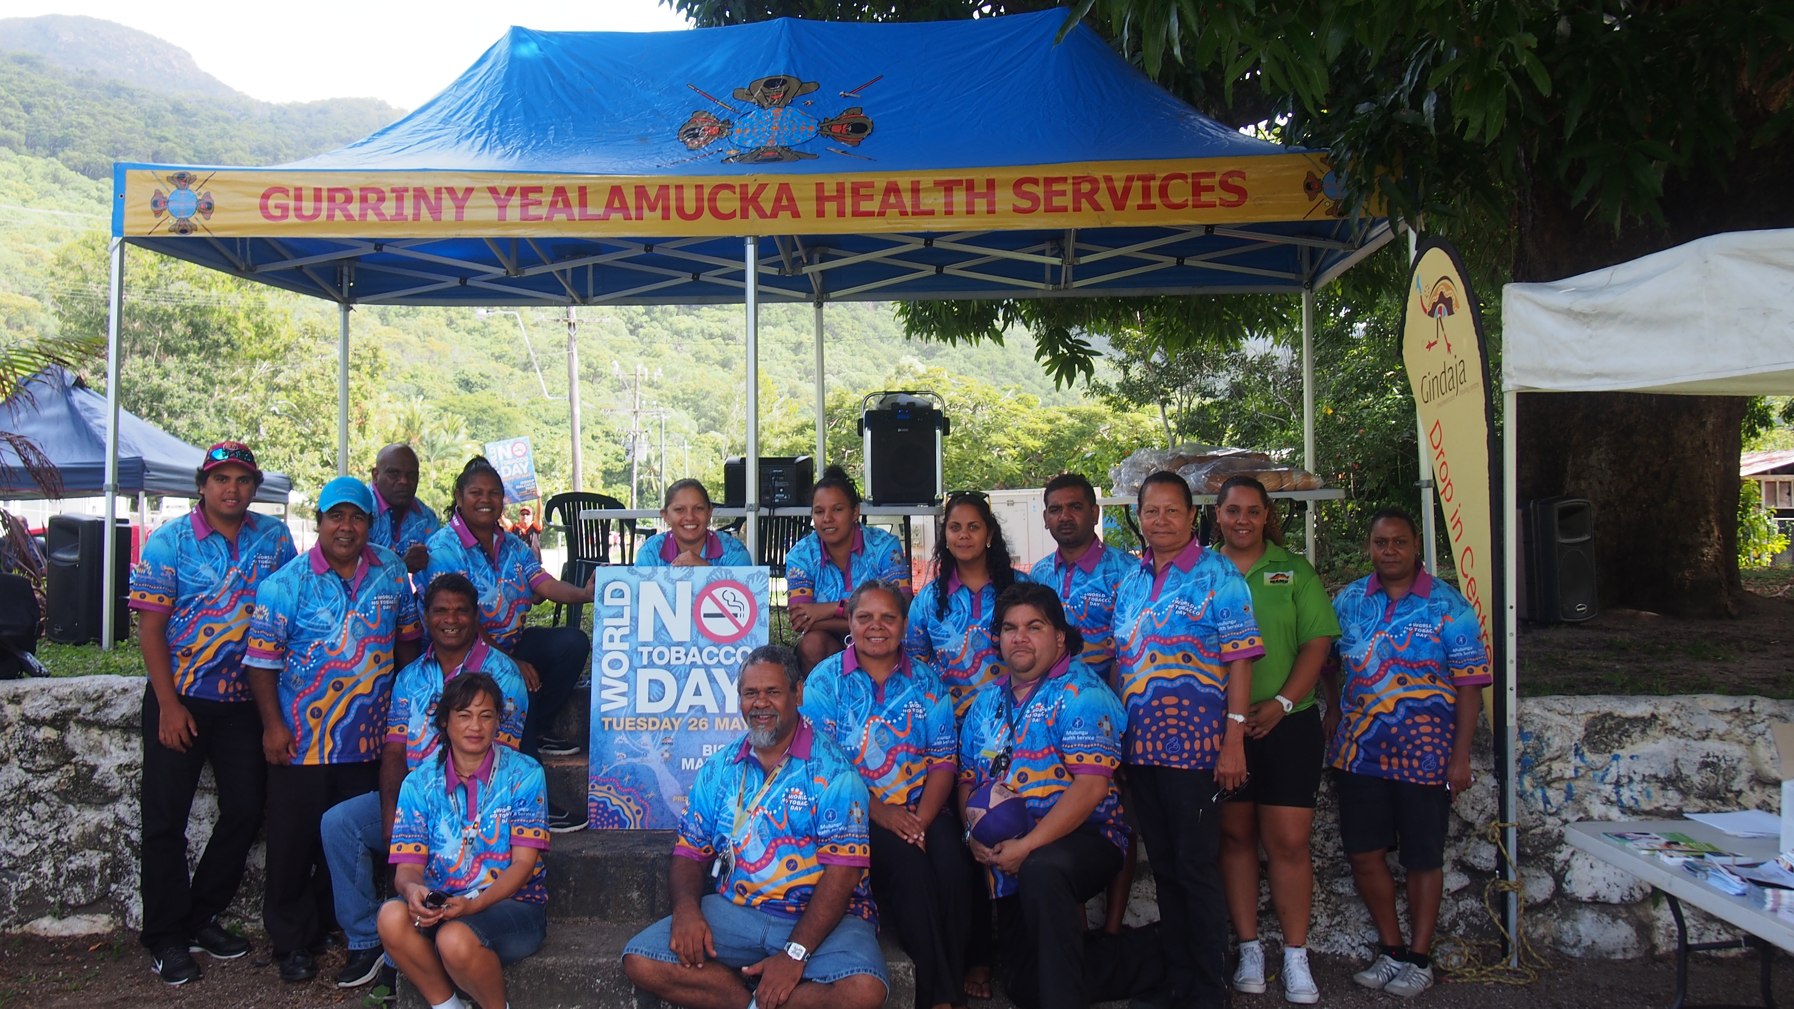
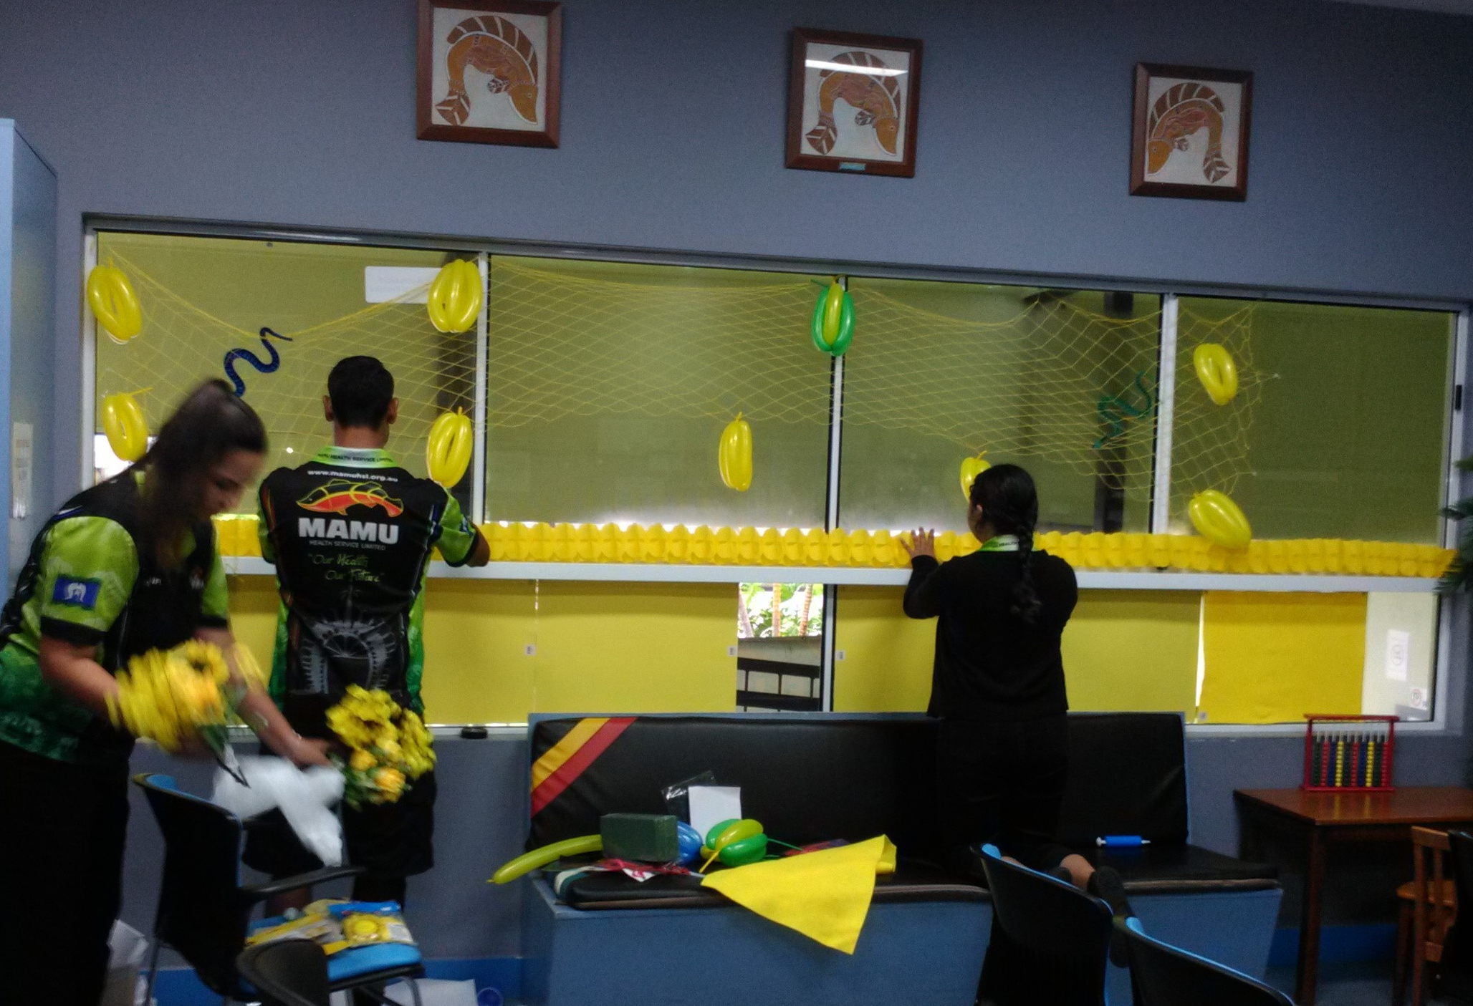
National Nutrition Week 2015 NAIDOC Week -2015 Staff participation – World No Tobacco Day – Yarrabah Pink Ribbon World’s Greatest Shave Biggest Morning Tea Melbourne Cup Deadly Choices Pink Ribbon
Pink Ribbon Day
NAIDOC day –Condom Man & SASHA
Health workers prepping for World Health day
National Nutrition Week - 2015
World’s Greatest Shave –
World NO Tobacco Day - Yarrabah
Deadly Choices Day
Feast of the Senses

Slide 7
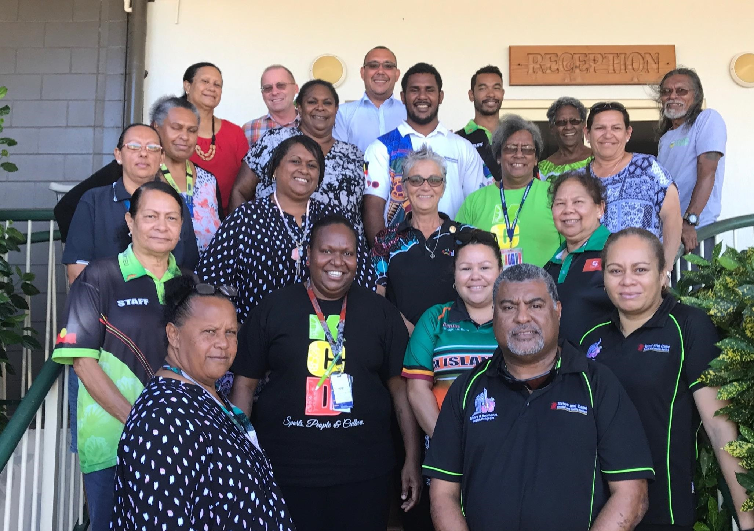
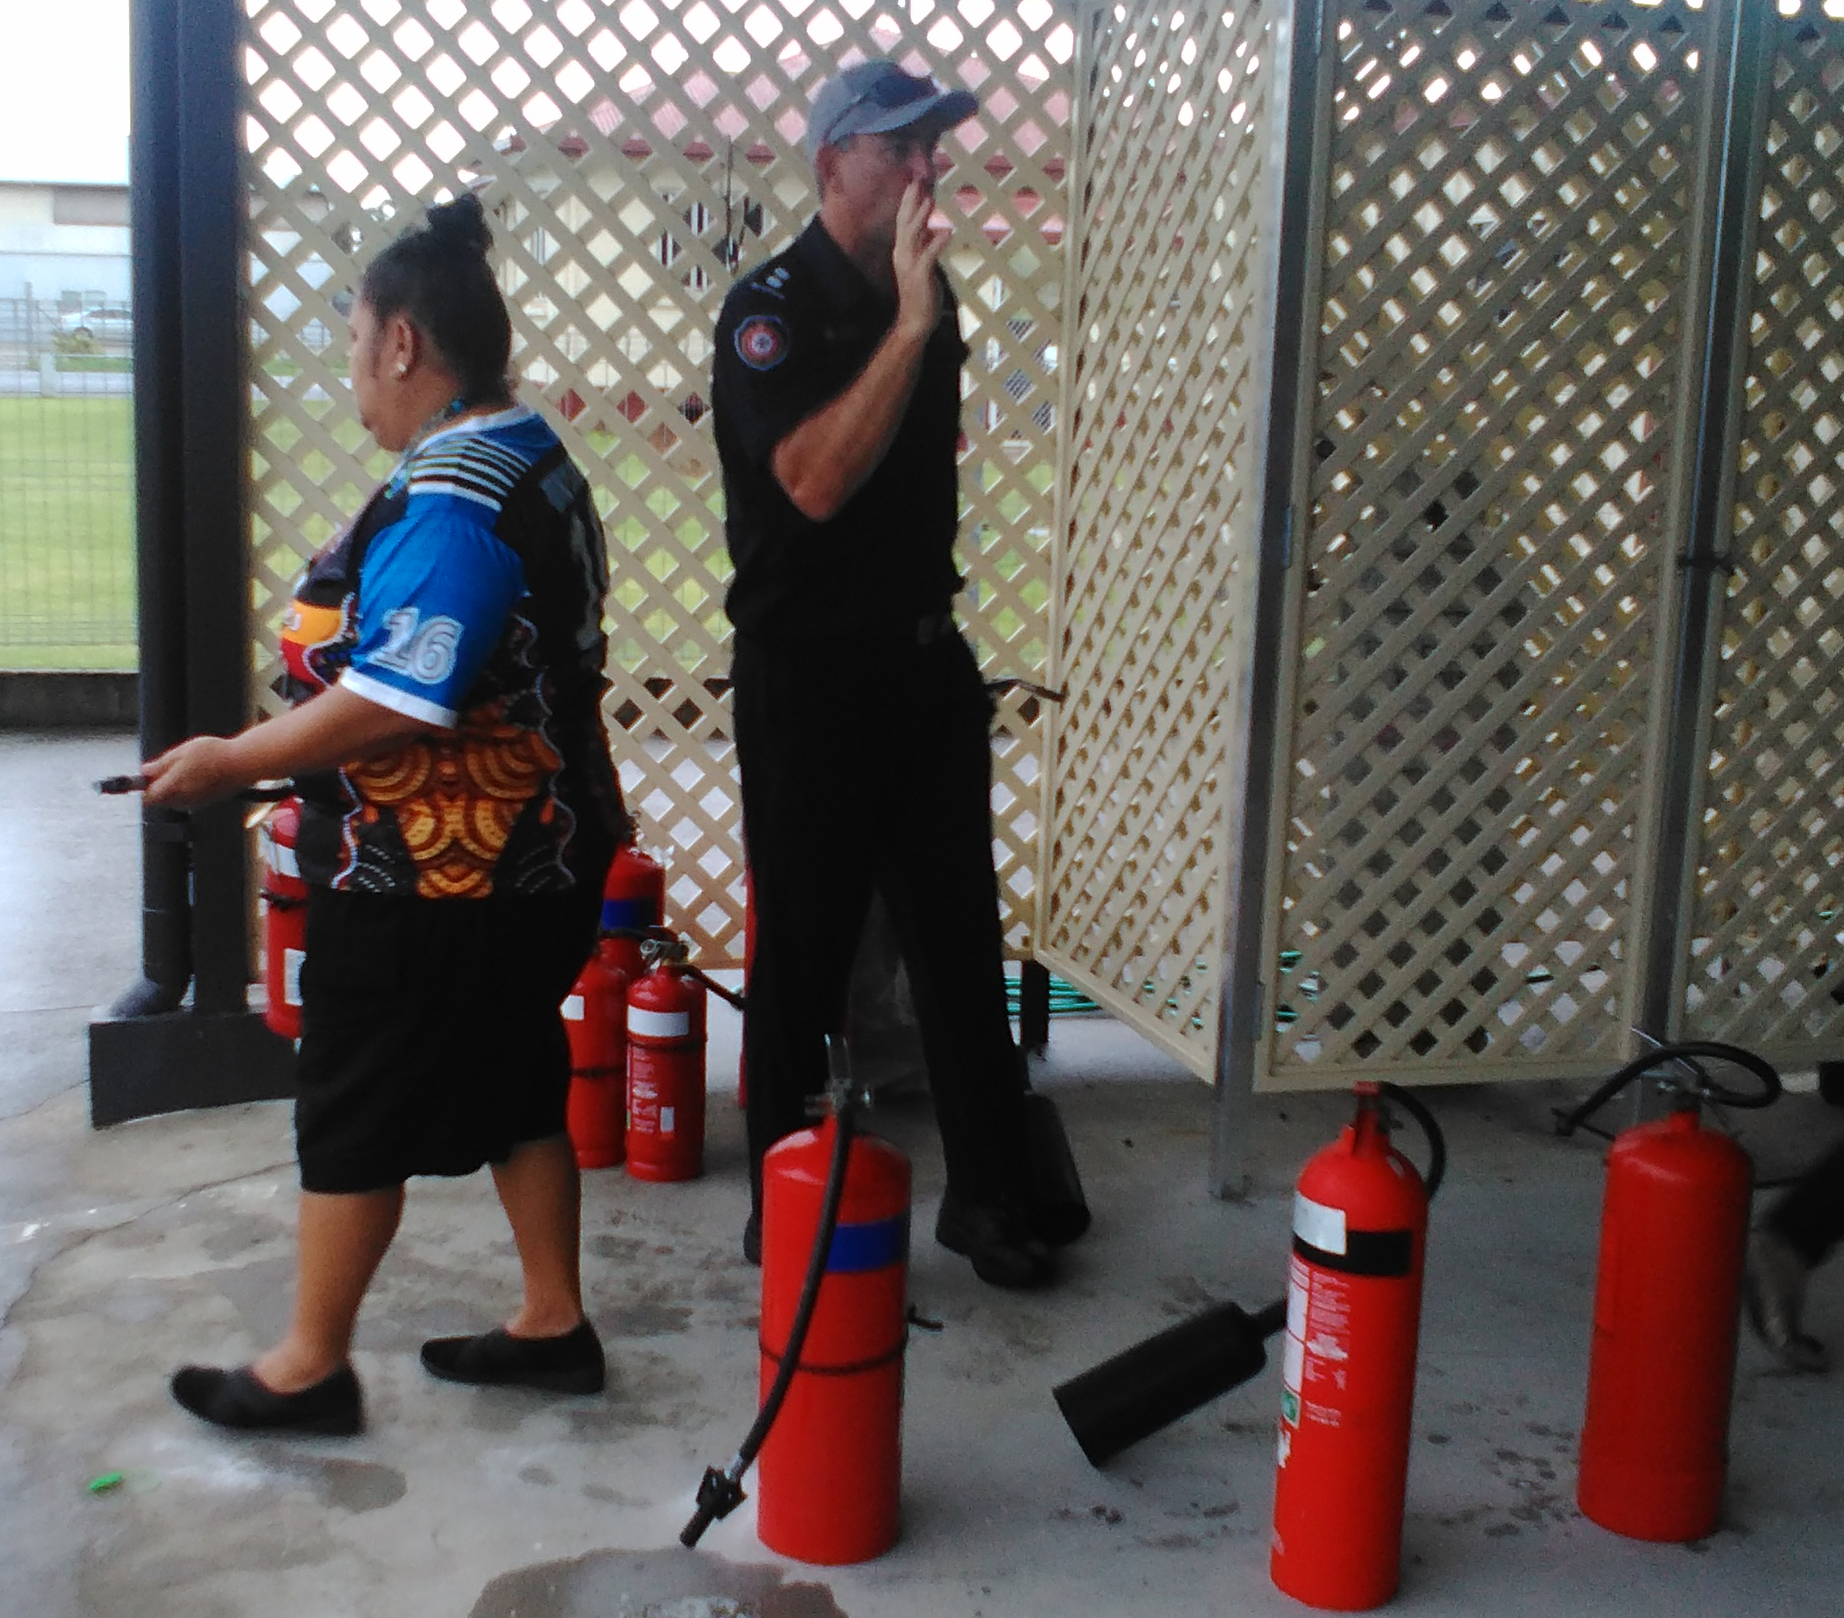
Training/Conferences/workshops
NATSIHWA Forum – Thursday Island
Joseph Drahm & Charlene Badham – Graduation 2007
First Response - 2016

Slide 8
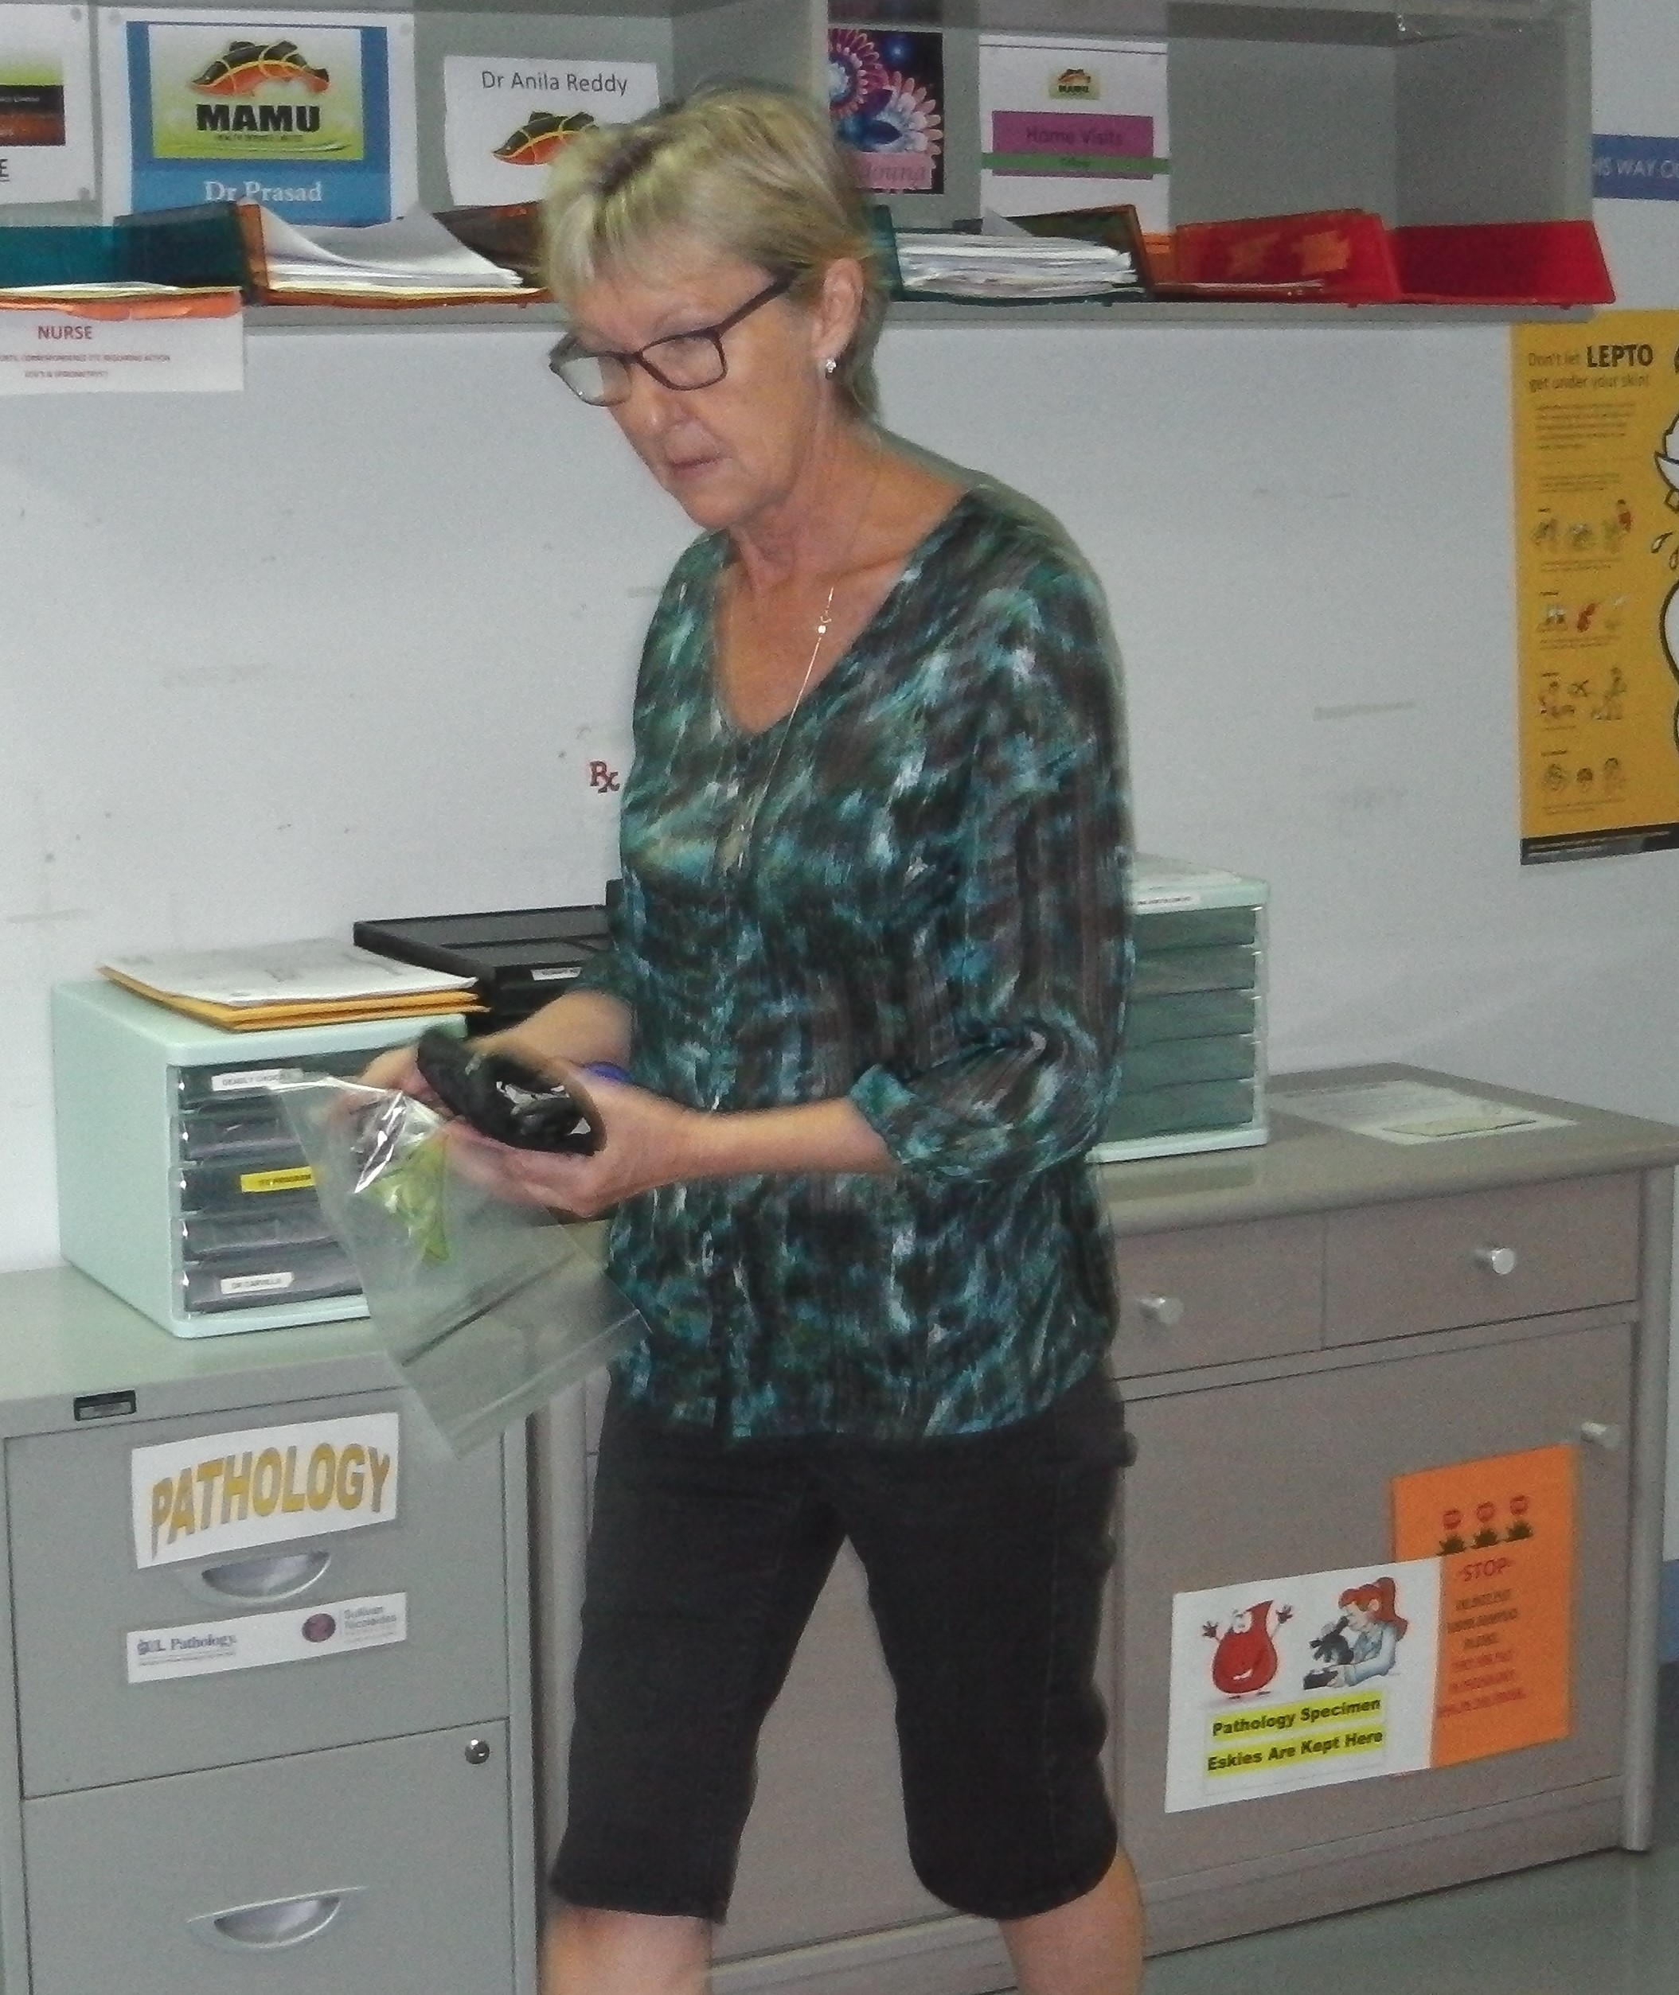
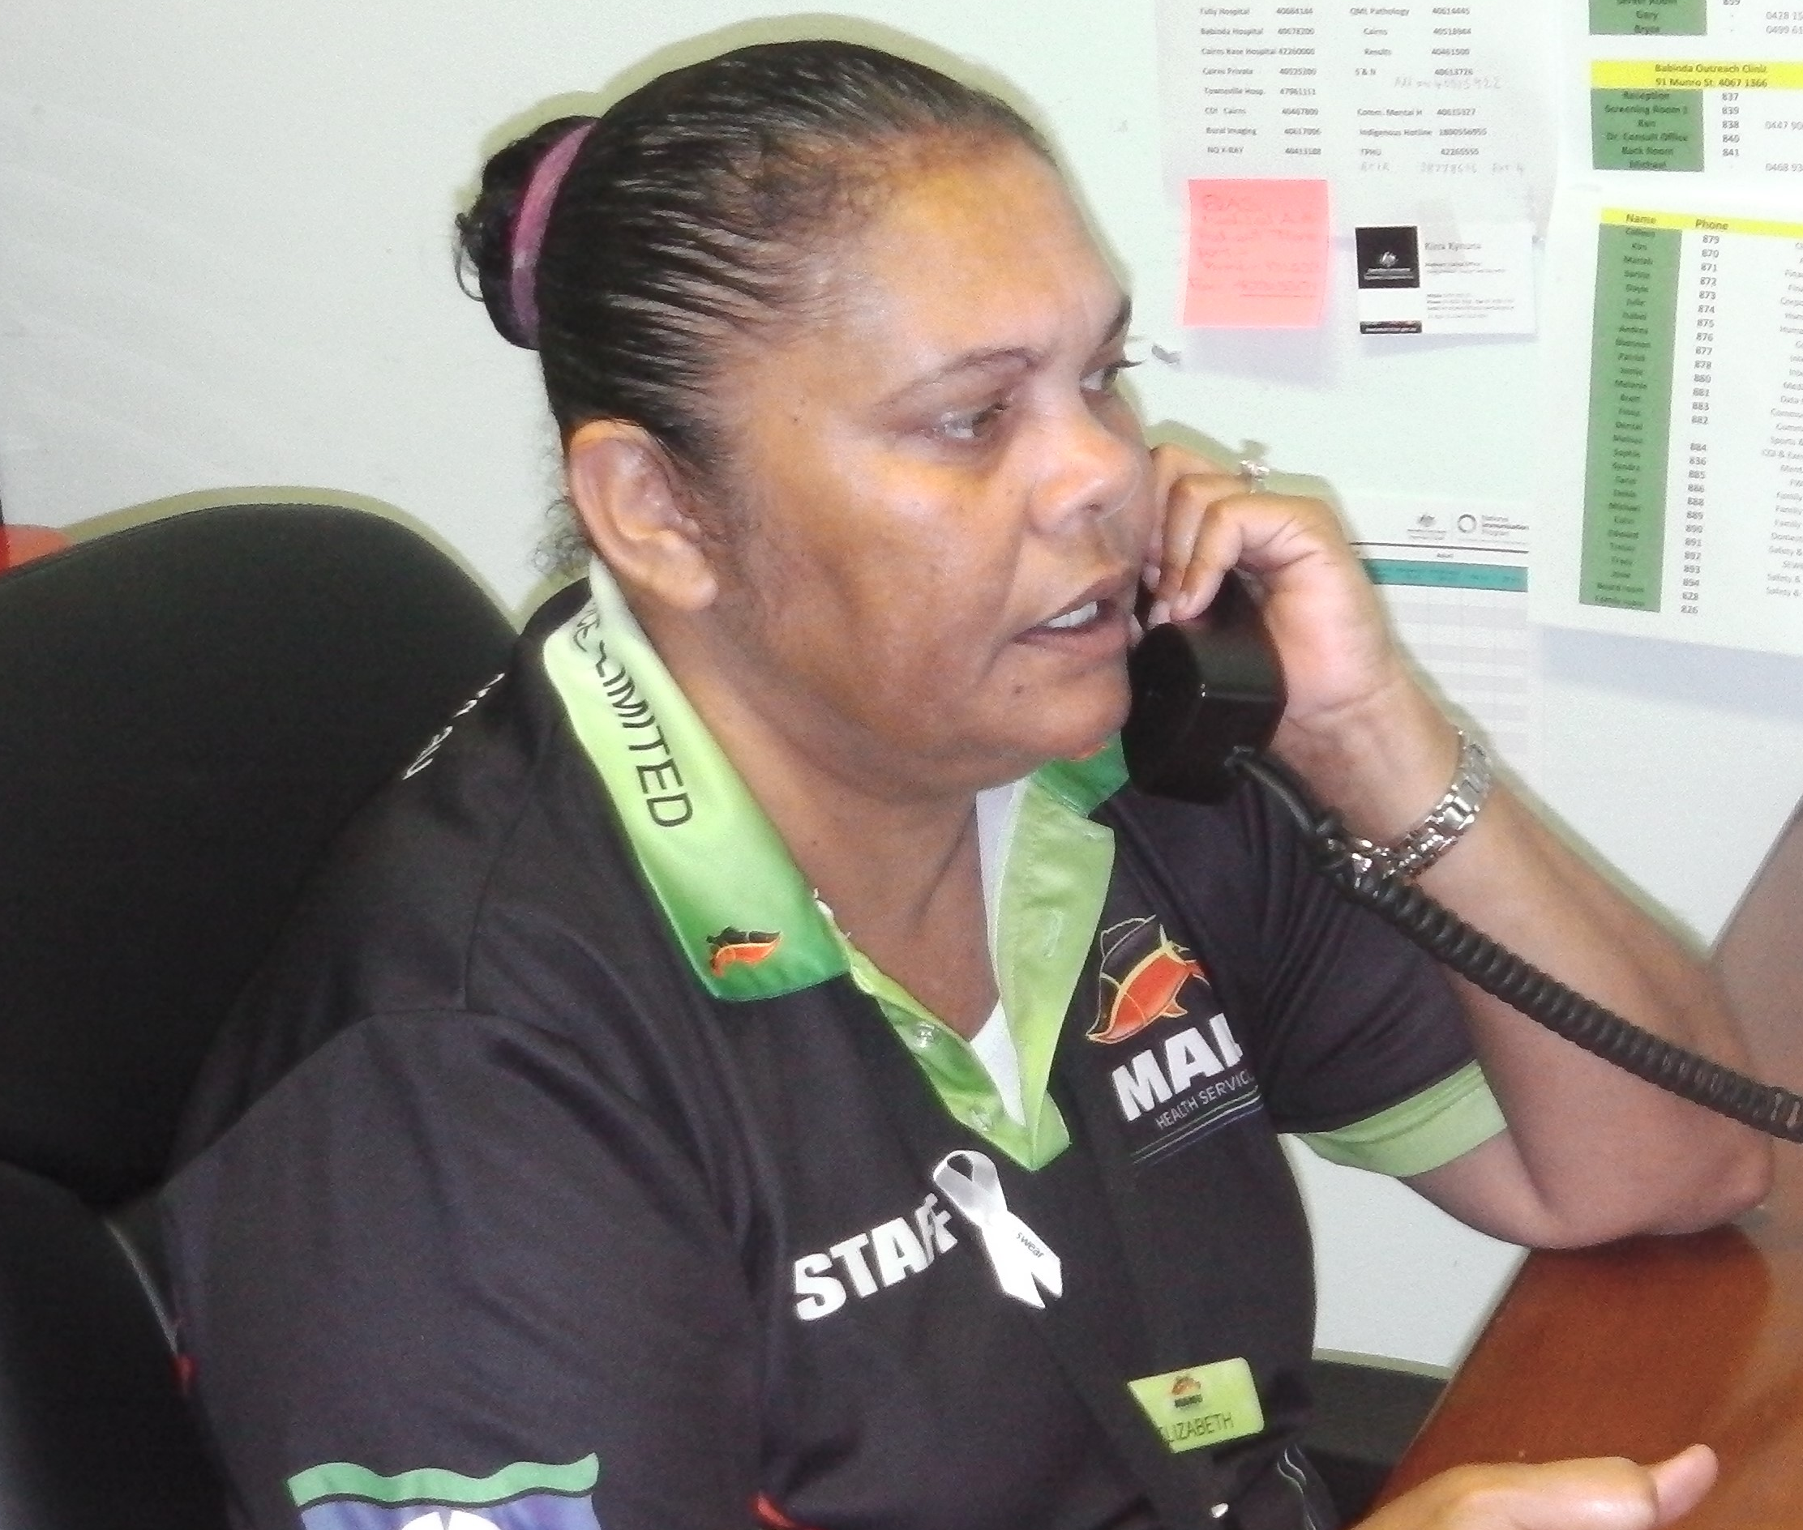
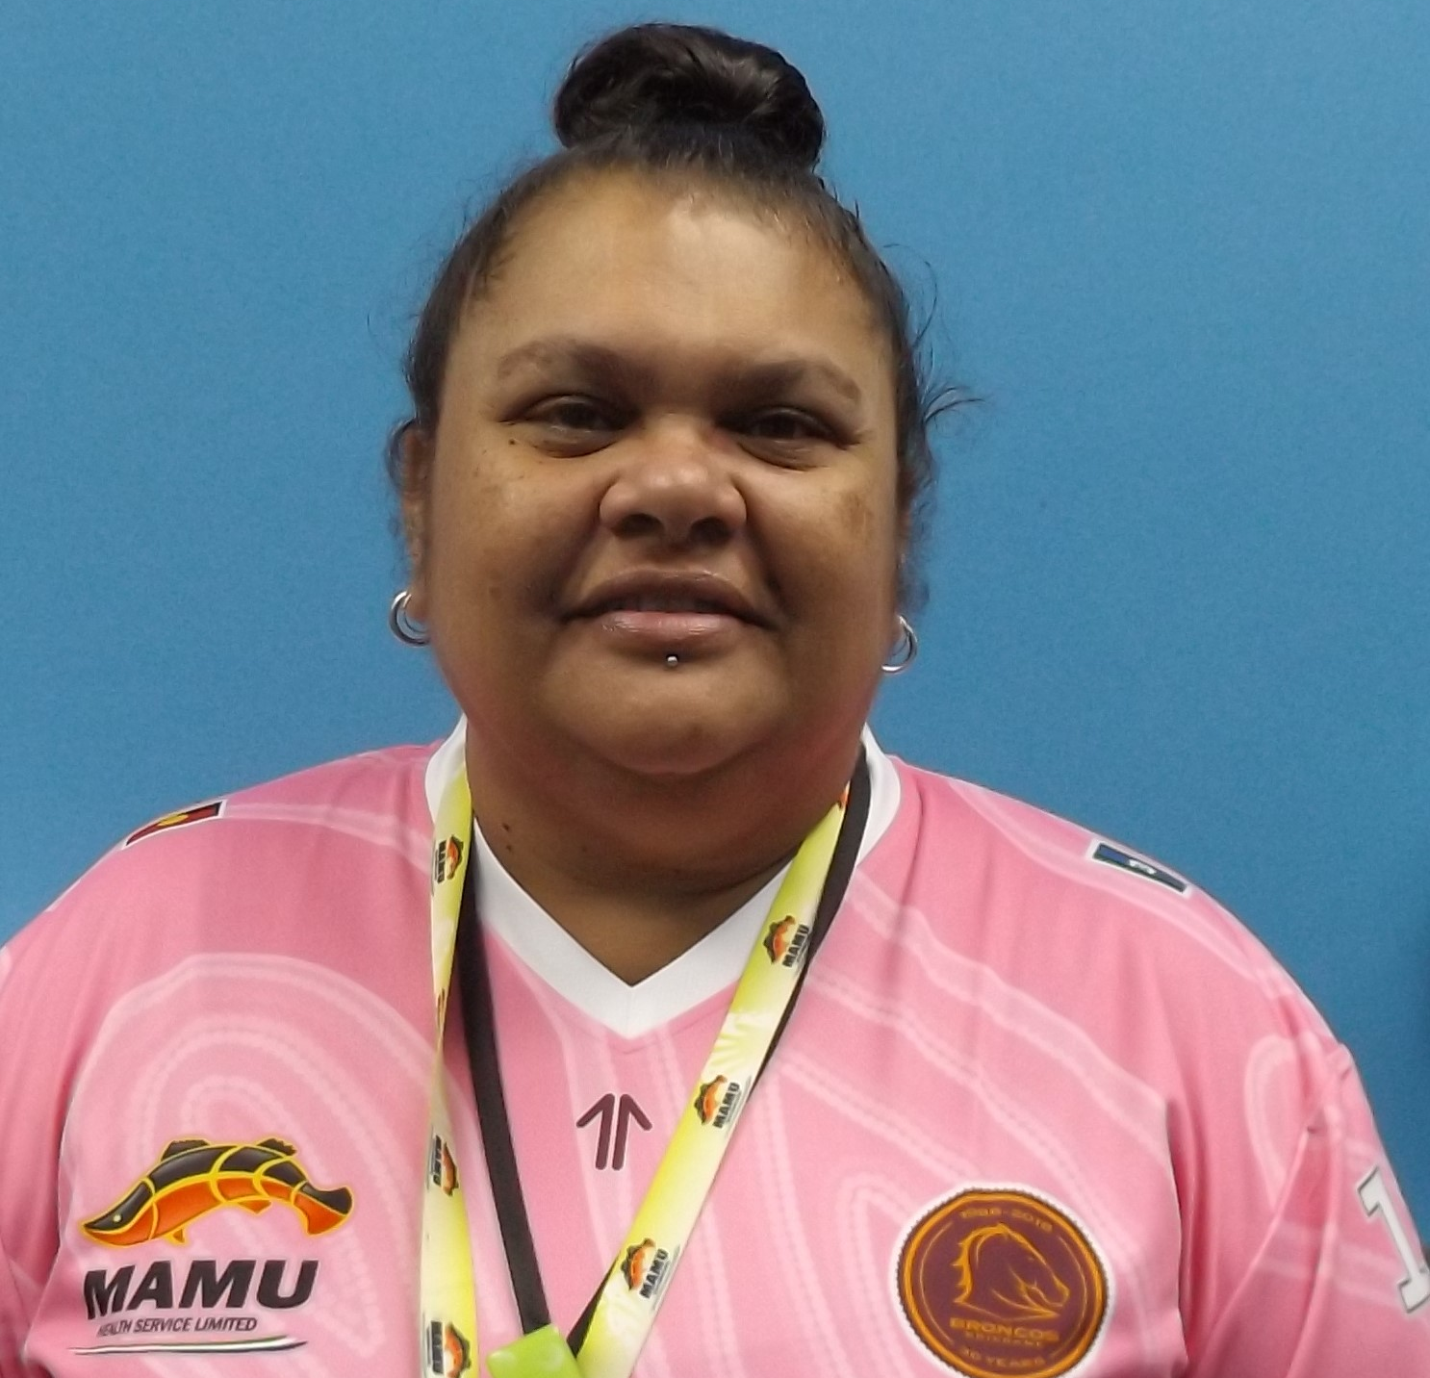
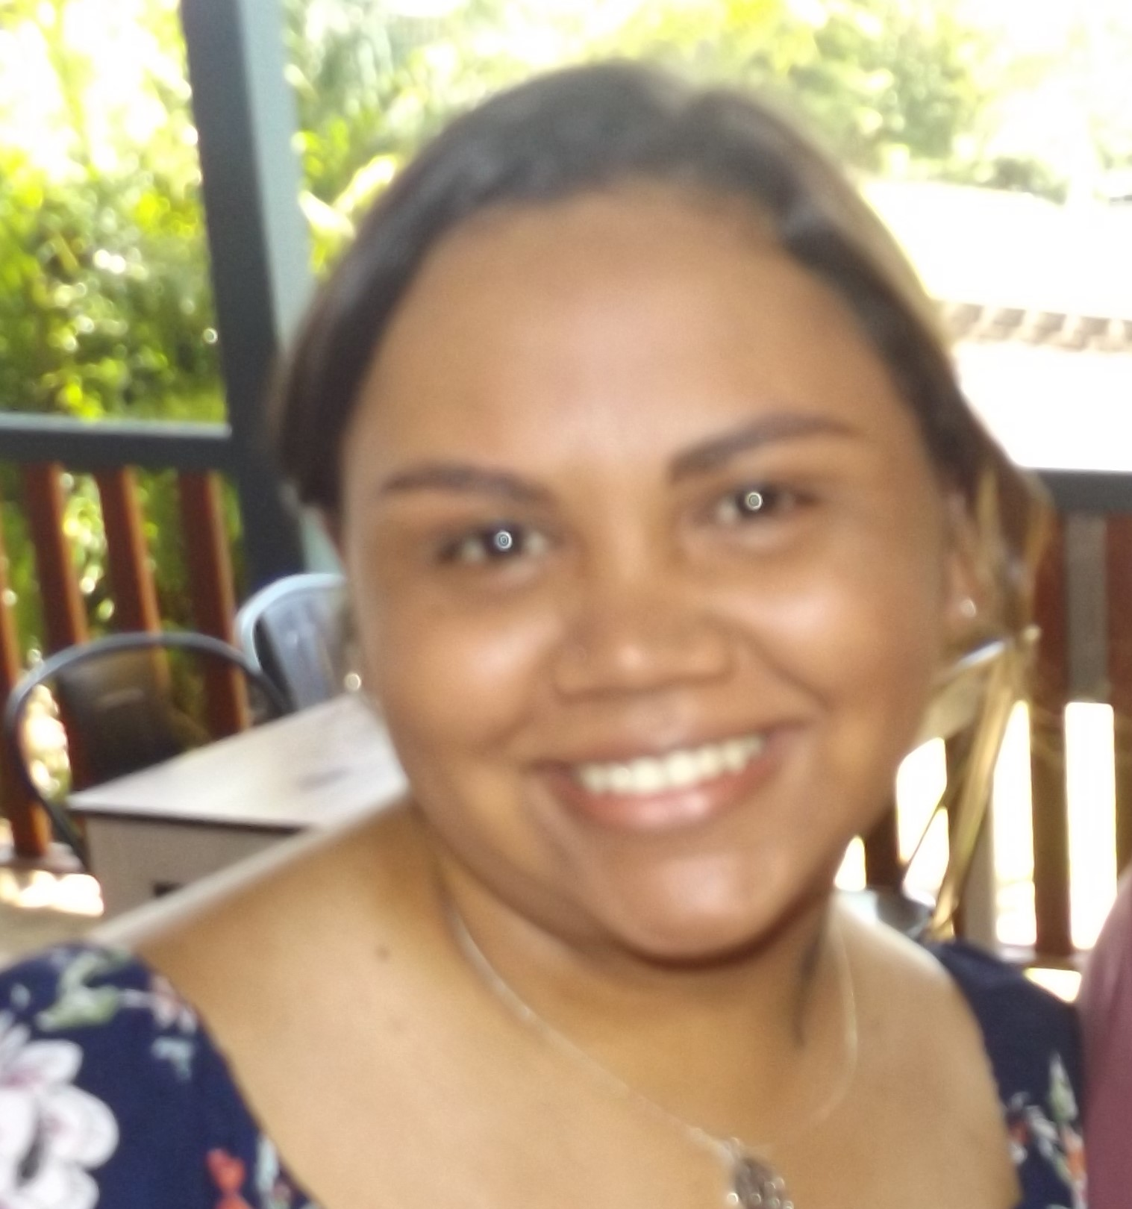
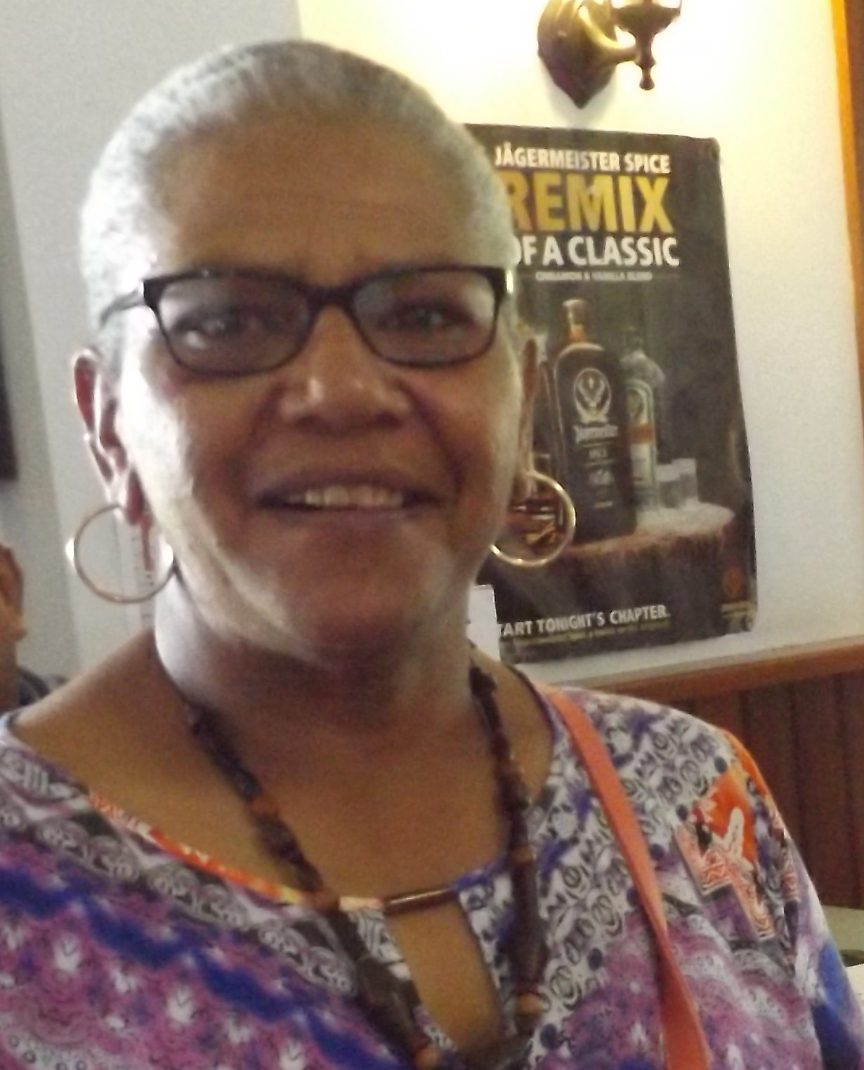
Staff today:
Charlene Badham – Clinic Coordinator
Carol Nucifora - EEN
Vicky Kyle – Medical Receptionist
Libby Johnson - AHW
Bryce – Transport/Maintenance
Larissa Sands – Trainee Medical Receptionist
Alana Purcell - AHW
Gary Kyle – Transport/Maintenance
Sharon Savage – Medical Receptionist/Transport Coordinator
Geno Ungil - RN

Slide 9
Past staff -
Debbie Luland Libby Bishop
Genelva McCarthy
Eric Crosbie
Dell Patterson Sue Hague
Michael Sands

Slide 10
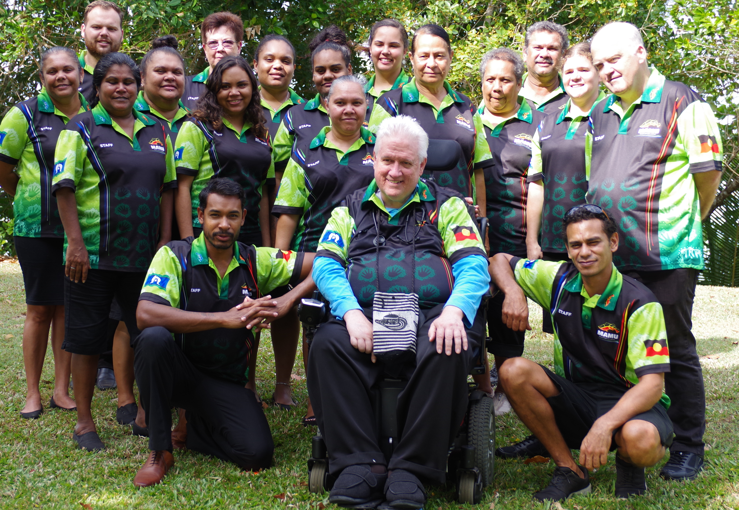
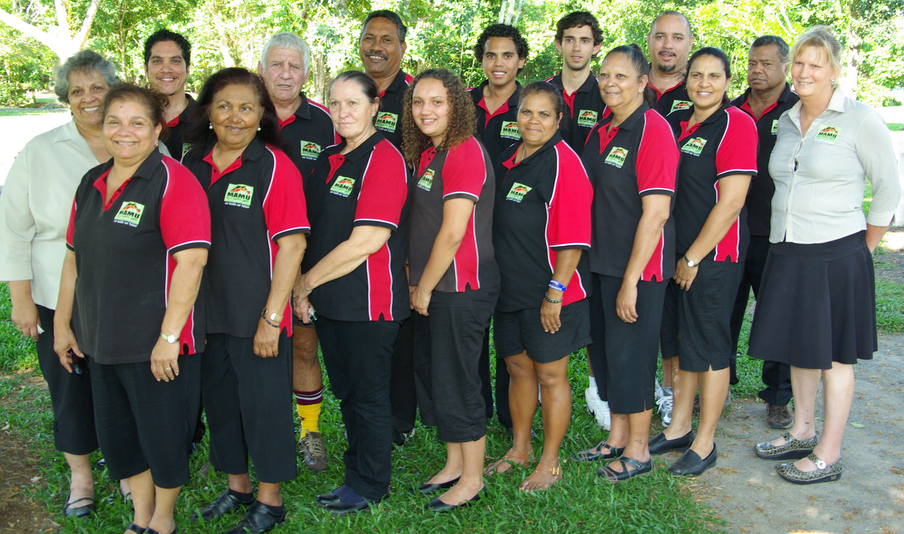
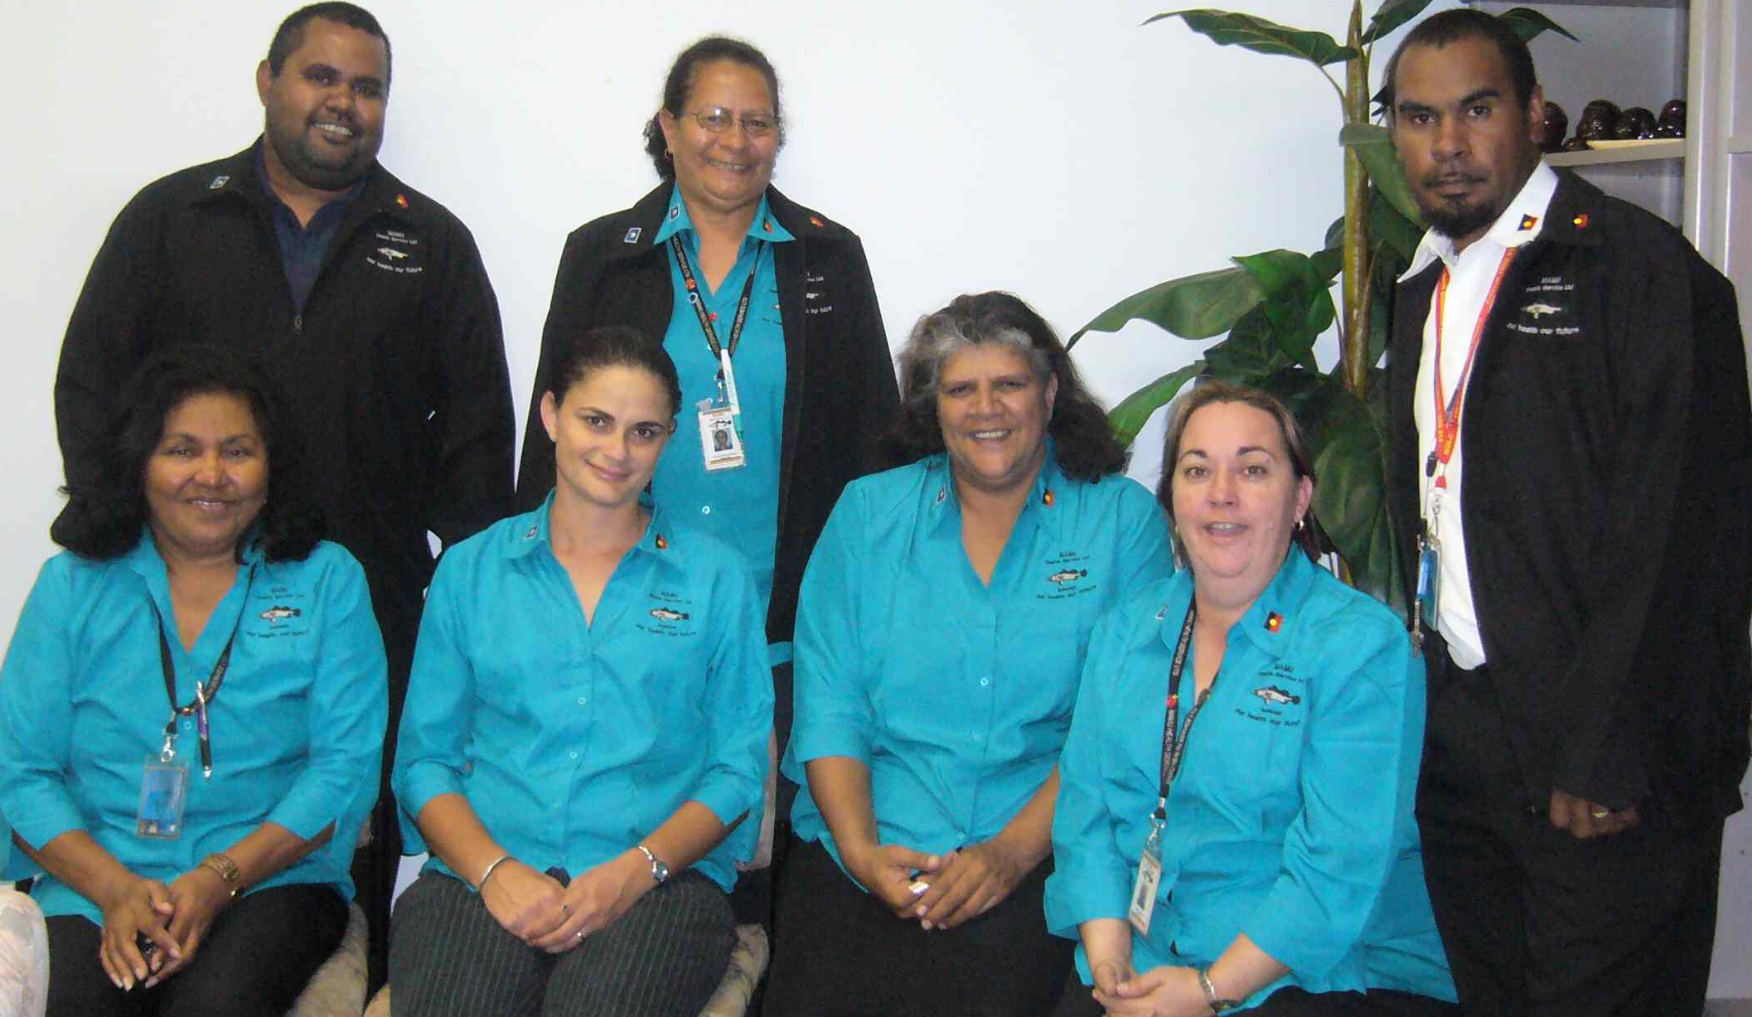
Staff photos
2017
2019
Innisfail PHC Clinical staff - 2008

Slide 11
Ran out of time to add the really fun bits….
Thank you for watching.
Until the next time..
Yawah…

