Slide 1
MAMU HEALTH SERVICE
On behalf of the elders past and present of Girrimay, Jittabul, Gulnay people of Tully we wish you welcome,
Welcome to our story – our history is long, our clients come from many diverse cultures our focus is the health and safety of our people both, Aboriginal and Torres Strait Islander
We are thankful that our team have a caring working relationship that network with the surrounding health organisations
Lets introduce our team from Tully -

Slide 2
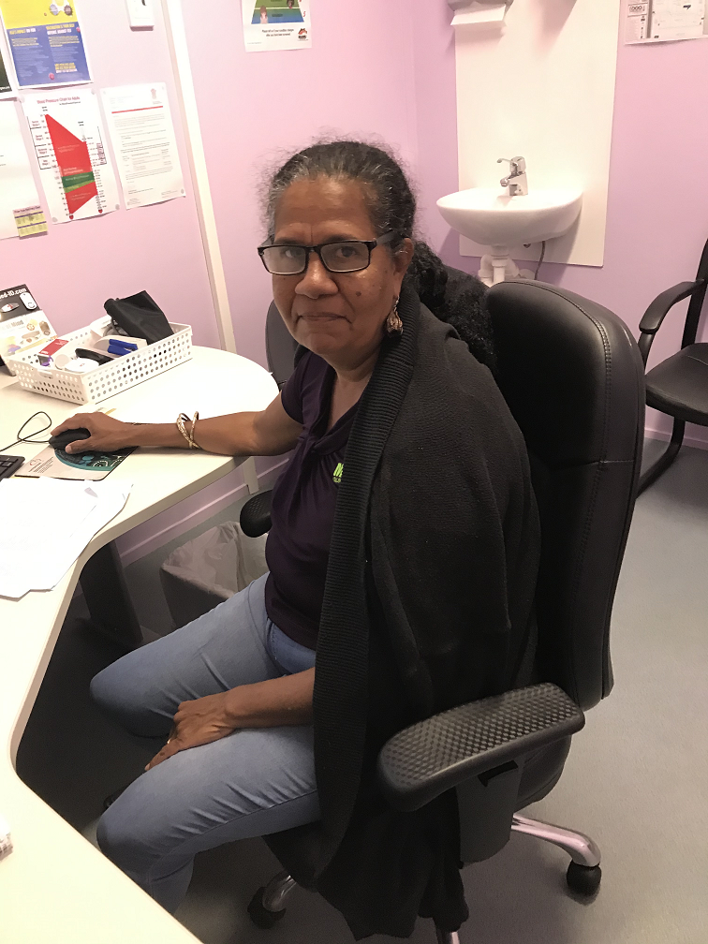
Clinical Co-ordinator
AKA Team leader :- LOLLIE
Lollie has brought team building enthusiasm, laughter and harmony in the clinic, building a healthy happy environment with work colleagues and clinical staff building memories that last a life time
Objective: team building and maintaining a healthy environment in house
Likes :- fishing, boating, eating black olive dip with chips
Dislikes :- being told what to do

Slide 3
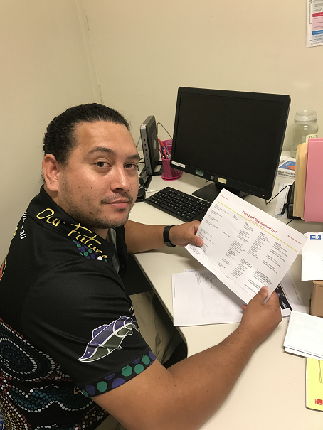
Transport driver- maintenance worker
The Maverick-driver and carer
Merrick is a excellent team member who has a high standard and duty of care for his clients, Merrick has built a good relationship and is highly regarded within the community and work colleagues
Objectives :- Male Health worker
Likes:- fishing, BCF, food
Dislikes:- hates losing to the BLUES

Slide 4
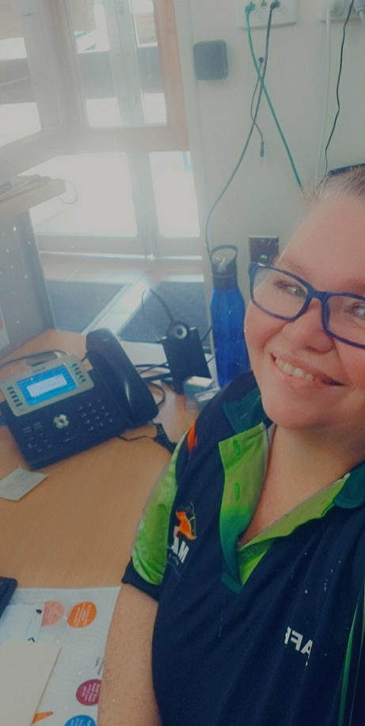
OUR FIRST CONTACT – MEDICAL RECEPTIONEST
Tanya has built a great relationship with clients as well with work colleagues her day to day job is very demanding making appointments to various outreach clinics
Objectives; keeping the office and clinic running smoothly for her co workers
Likes: relaxing, refilling lolly jar
Dislikes:- arrogant and demanding people

Slide 5
EXCITIVATE HEALTH WORKER
Bronwyn senior our most health worker, otherwise known to many as Bon Bon, her familiar characteristic’s is what makes many clients happy to return to Mamu Health always putting clients health first she is valuable person in our clinic
Objective:- making it a joyous first contact
Likes:-people, laughing, fish
Dislikes:-not smoking

Slide 6
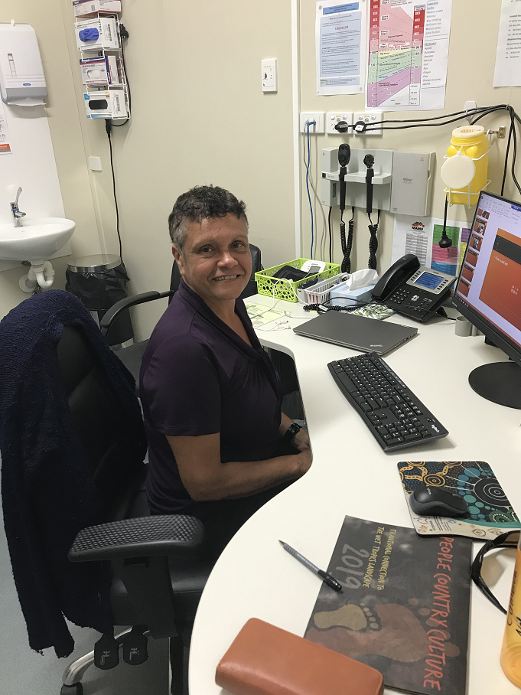
HEALTH WORKER
ALLISON has recently come on board with us as a health worker, it is great to see new faces coming up through the health system. Allison works well in our team environment and can work on her own, asks many questions and always willing to help out where needed
Meeting the different expectations of the clinic is a challenge but as a team we strive to do our best
Objective:- to be an equal team player
Likes:- fishing, camping, chilling around a fire
Dislikes:- being late

Slide 7
MALE HEALTH WORKER
JOSH – has been working at the Tully clinic now for some time,
Josh has built a good repour within our clinic with both client and work colleagues. Josh works well in a team or by himself, he also doubles as a driver for our clients
Objectives:- doing programs
To achieve goals
Likes:- gym, exercise,
Dislikes:- Merrick winning

Slide 8
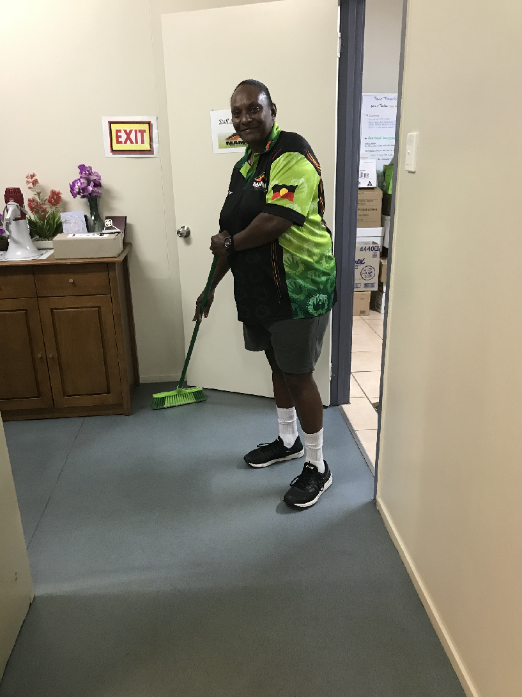
OUR CLEANER
Deb, what a honest and good person she is, very helpful always has a smile on her face happy to ask how has your day been always goes over and beyond to help the clinic. Deb is a valued member of our team she makes us a complete team
Objectives:- to become a health worker
Likes :- laughter
Dislikes:- picking up after people, rude people

Slide 9
OUR WEEKLY TOOLBOX
As you can see our Tully targets have not changed since being written up our daily target board but they have dropped since covid arrived this meant us closing our doors to many clients and finding other ways to reach them. Through many weekly phone calls we were able to keep in contact with them, they would let us know if they weren't feeling the best. Now it is nearly back to normal and with Dr Alana on our Dr days we are flat out.

Slide 10
OUR TREATMENT ROOM
This is where all the magic happens, this is Julies and cathys domain. Here is where the nurses perform their magic with everything on hand always working in a caring and gentle environment they are a complement to our team. With one day a week sometimes two days Julie and Cathy are always supportive to our clients and the Doctors and staff.

Slide 11
DRS ROOM - MS BOSS
This is the buzz of the clinic Doctor Alana’s room. This is most feared room of the health workers as this room seems to echo health worker health worker/ emergency emergency !!!!
Since Dr Alana’s been here her reputation as being through with all the clients, the community is better for having her as their doctor as well as all the other clinics
Objectives :- wishing there was 5 o'clock somewhere
Likes :- loves Tully clinic
Dislikes:- work colleagues not doing their jobs

Slide 12
DONATED BY TULLY LIONESS CLUB DOMESTIC VIOLENCE SEAT
This bright red seat was kindly donated to the clinic by the Tully Lioness Club in Tully in relation to domestic violence
The seat seems to be a well used piece of furniture providing a resting place for our clients especially on cold winter days

Slide 13
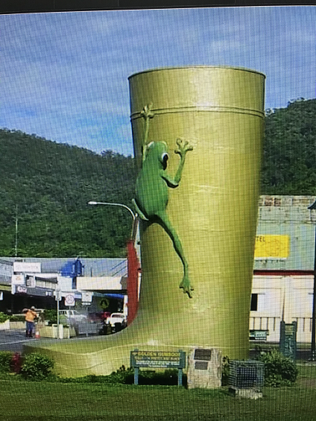
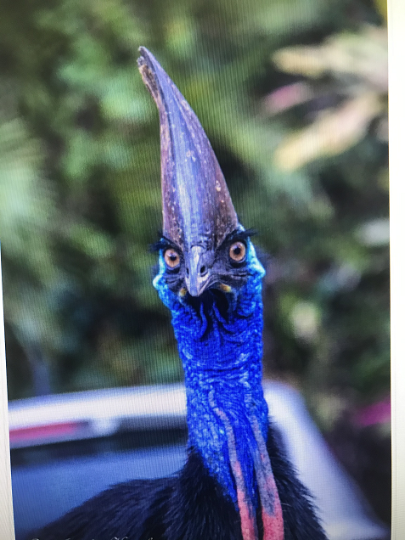
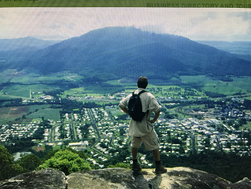
This is TEAM TULLY a wonderful place to work

Slide 14
TULLY TEAM

